Slide 1
Juniper Apstra 4.2.1 EVE-NG Virtual Lab Demo Video series companion guide Video 10: Day-1 Internet Connectivity
Colin Doyle, Sr. CE AMER
See the complete video walkthrough on YouTube at: https://www.youtube.com/@5minutejunos
Ask questions at the Juniper Elevate Community using the hashtag #5minutejunos
Adapted from v4.0.0 documentation originally compiled by: - Raymond Lam, SSE APAC - Tony Chan, SSE APAC

Slide 2
Agenda
Prepping your Lab
Day-0 Fabric Onboarding
Virtual Device Profile Verification
Virtual Device Profile Cloning
Onboarding Virtual Nodes
Create ASN Pool and IP Pools
Create Logical Devices and Interface Maps
Create Rack Types
Create Templates
Create Blueprints
Day-1 Service Provisioning
Create Routing Zones
Create Virtual Networks
Assign Virtual Network to Switchports
Add Server Links
Data Center Interconnect
DCI Addendum: Direct Peering
Core/WAN Connectivity
Internet Connectivity
Day-2 Operational Scenarios
Incorrect Cable Patch (RCA, LLDP Link Discovery, Time Voyager)
Config Deviation Checking
Apply custom config through Configlet
View Telemetry Data
Hardware Replacement
Future Documentation
Firewall Service Chaining
Cluster with Service Block
Type-5 Route (fabric integrated) with MNHA
VLAN Stitching
vEvo Fabric

Slide 3
Day-1 Service Provisioning
Create Routing Zones
Create Virtual Networks
Assign Virtual Network to Switchports
Add Testing Hosts
Data Center Interconnect (OTT)
DCI Addendum – Direct Peering
Core Connectivity
Internet Connectivity

Slide 4
Connecting My Lab to the Internet - Overview
At this point, we have built our “Core” connectivity by peering our external routers directly with Tenant-1 VRF on the fabric border routers in each DC and advertising a default route into that VRF.
Depending your requirements, you may opt to add additional non-fabric network nodes, hosts, and/or other virtual devices to your lab to develop and test fabric<->core connectivity.
My lab is connected to an isolated lab network at my house that allows me to connect physical hardware, other running virtual labs, and provide Internet connectivity.
This section will detail my setup. As always, take from it what you need to meet your own requirements, or skip this section all together if you have what you need already.

Slide 5
Connecting My Lab to the Internet - Overview
Bits and Pieces:
To simplify routing, the WAN_Sim node is a vSRX and will be configured with sNAT
The WAN_Sim ge-0/0/2 interface will be assigned a static IP via DHCP by my WAN firewall gateway
I’ll configure a default route on the WAN_Sim node to my WAN firewall gateway
There’s an upside and a downside to doing sNAT this way:
Upside – The WAN_Sim node is being assigned an IP address from an address pool that is already configured for routing and connectivity to the public Internet. sNAT allows me to enable routing for hosts in the lab without any additional configuration on my Internet firewall.
Downside – This only allows Internet connectivity from the lab – I cannot connect to anything inside the lab from outside the lab. That’s because we’re doing double-NAT, so my other networks don’t see the networks in the virtual lab, only the ge-0/0/2 interface on the WAN_Sim node.
To test from hosts outside your virtual lab, more configuration is required. Ditch NAT on the WAN_Sim, run an IGP between your non-fabric virtual and physical routers, configure your Internet firewall NAT and security policies for the lab networks, etc… Or use statics – whatever suits you.
To simplify security bits, all interfaces will be added to the default “trust” security-zone
For fun, P2P OSPF will be used to connect ext-rtr1/ext-rtr2 to the WAN_Sim node
I’ll detail the Import/Export policy updates required for this to work properly – that’s the fun part!

Slide 6
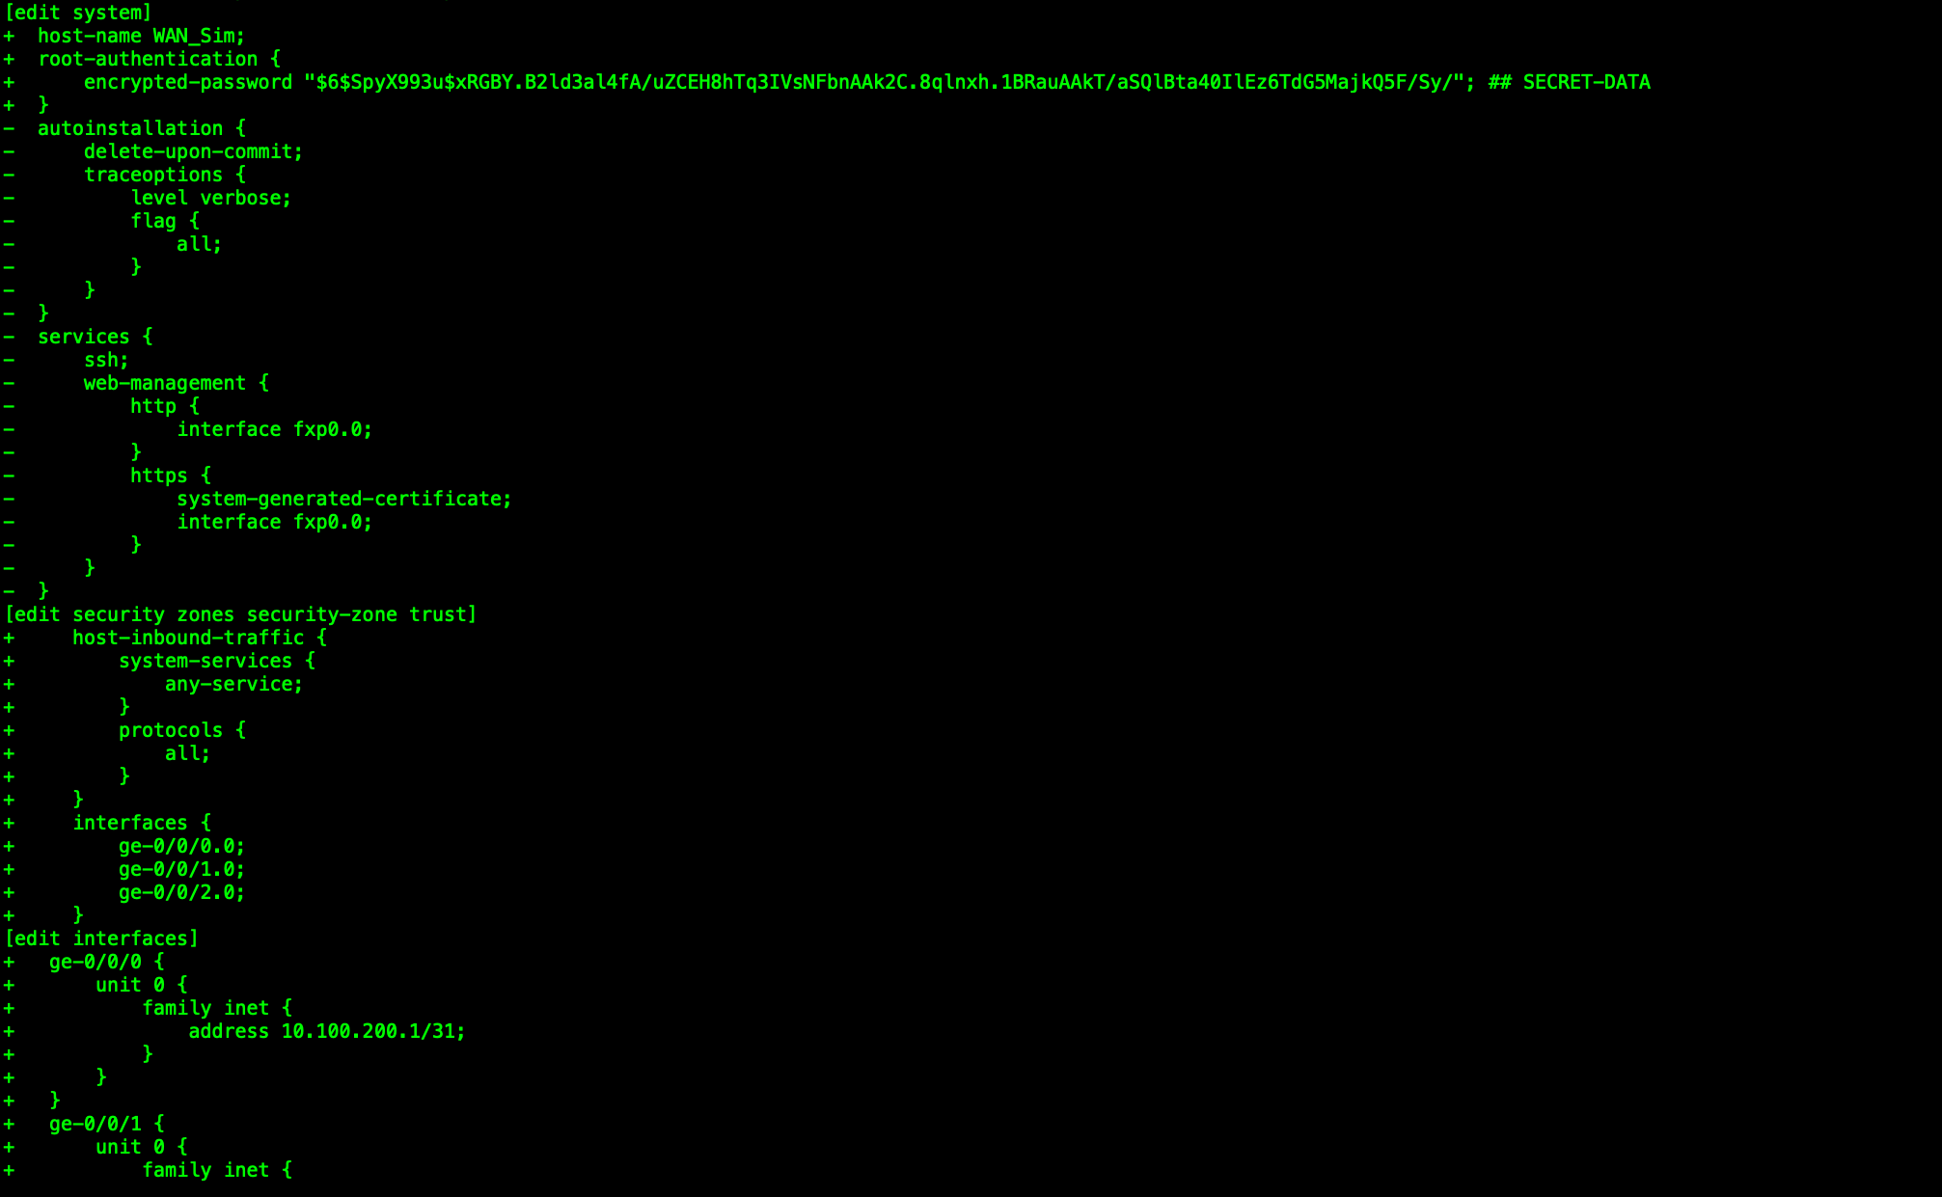
Configure WAN_Sim Connectivity to Internet Gateway
Configure:
set system root-authentication plain-text-password (Juniper)
set system host-name WAN_Sim
delete system services
wildcard range set security zones security-zone trust interfaces ge-0/0/[0-2].0
set security zones security-zone trust host-inbound-traffic protocols all
set security zones security-zone trust host-inbound-traffic system-services any-service
set interfaces ge-0/0/0.0 family inet address 10.100.200.1/31
set interfaces ge-0/0/1.0 family inet address 10.100.201.1/31
set interfaces ge-0/0/2.0 family inet dhcp
commit and-quit
Verify address on ge-0/0/2 if using DHCP
show interfaces terse ge-0/0/2
Note: vSRX can be moody about DHCP at times. If you aren’t getting a lease, reboot the node. If it continues to be a problem, just set a static and don’t forget to add a static default route as well.

Slide 7
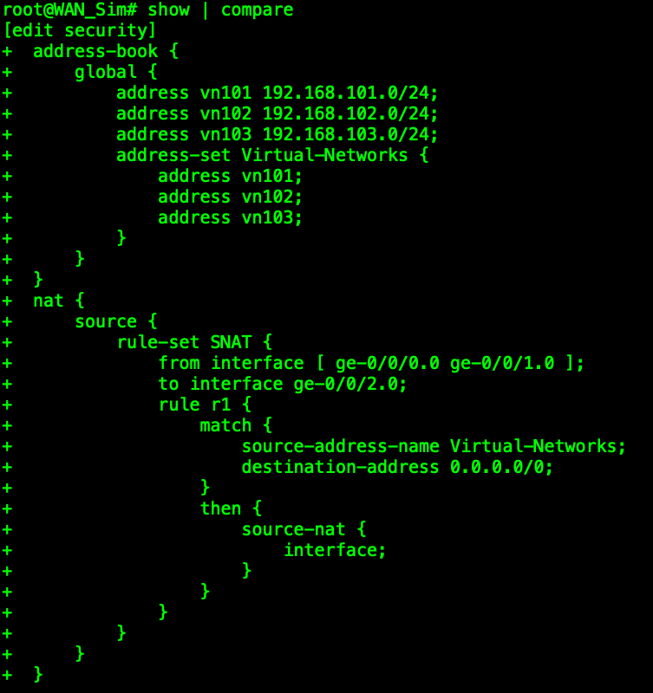
Configure WAN_Sim sNAT
Configure:
set security address-book global address vn101 192.168.101.0/24
set security address-book global address vn102 192.168.102.0/24
set security address-book global address vn103 192.168.103.0/24
wildcard range set security address-book global address-set Virtual-Networks address vn10[1-3]
set security nat source rule-set SNAT from interface [ ge-0/0/0.0 ge-0/0/1.0 ]
set security nat source rule-set SNAT to interface ge-0/0/2.0
set security nat source rule-set SNAT rule r1 match source-address-name Virtual-Networks
set security nat source rule-set SNAT rule r1 match destination-address 0/0
set security nat source rule-set SNAT rule r1 then source-nat interface
commit and-quit
Verify config (no translations at this point)
show security nat source rule r1

Slide 8
Configure ext-rtr1 and ext-rtr2 Connectivity to WAN_Sim
Configure ext-rtr1:
set interfaces ge-0/0/3.0 family inet address 10.100.200.0/31
commit and-quit
Configure ext-rtr2:
set interfaces ge-0/0/3.0 family inet address 10.100.201.0/31
commit and-quit
Verify
Ping between everything

Slide 9
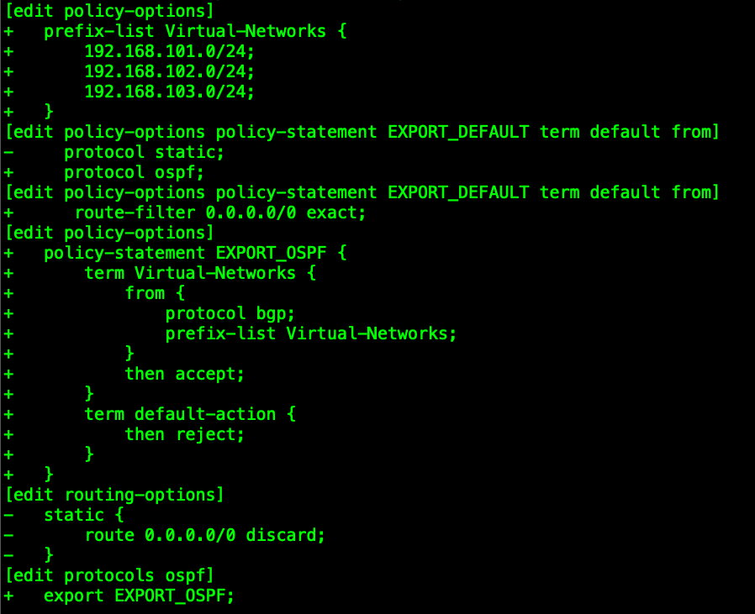
Configure P2P OSPF
ext-rtr1 and ext-rtr2 (config elements are identical)
delete routing-options static
delete policy-options policy-statement EXPORT_DEFAULT term default from
set policy-options policy-statement EXPORT_DEFAULT term default from protocol ospf route-filter 0.0.0.0/0 exact
set protocols ospf area 0 interface ge-0/0/3.0 interface-type p2p
wildcard range set policy-options prefix-list Virtual-Networks 192.168.10[1-3].0/24
set policy-options policy-statement EXPORT_OSPF term Virtual-Networks from protocol bgp prefix-list Virtual-Networks
set policy-options policy-statement EXPORT_OSPF term Virtual-Networks then accept
set policy-options policy-statement EXPORT_OSPF term default-action then reject
set protocols ospf export EXPORT_OSPF
commit and-quit

Slide 10
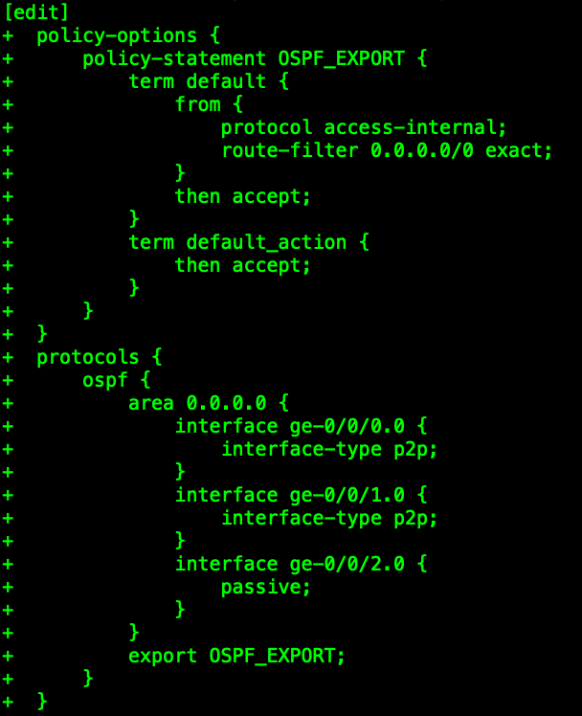
Configure P2P OSPF
WAN_Sim
If you are using DHCP for your WAN IP and default gateway:
set policy-options policy-statement OSPF_EXPORT term default from protocol access-internal route-filter 0.0.0.0/0 exact
If you are using a static IP for your WAN connection:
set routing-options static route 0/0 next-hop <g/w address>
set policy-options policy-statement OSPF_EXPORT term default from protocol static route-filter 0.0.0.0/0 exact
set policy-options policy-statement OSPF_EXPORT term default then accept
set policy-options policy-statement OSPF_EXPORT term default_action then accept
wildcard range set protocols ospf area 0 interface ge-0/0/[0-1].0 interface-type p2p
set protocols ospf area 0 interface ge-0/0/2.0 passive
set protocols ospf export OSPF_EXPORT
commit and-quit
Since I’m using DHCP for my WAN interface IP and to program my default gateway, my export policy references “access-internal” as the protocol.

Slide 11
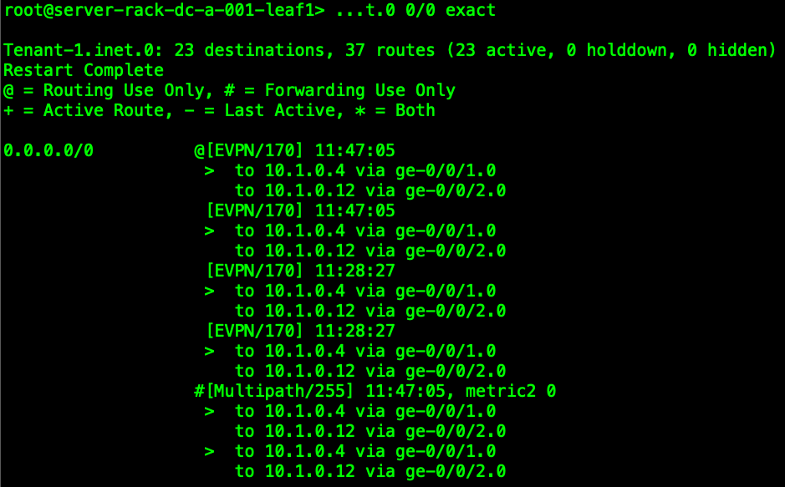
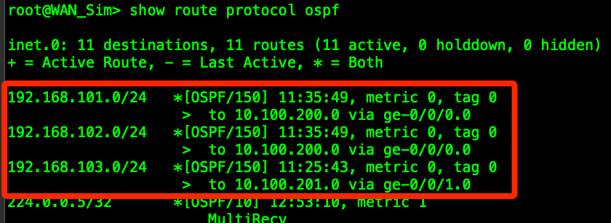
Verify Internet Connectivity Default Route from WAN_Sim to Server Leafs
WAN_Sim: show route 0/0 exact > check next-hop and interface. source will vary depending on whether you are using DHCP (Access-Internal) or Static
ext-rtr’s: show route advertising protocol bgp <peering IP address of connected border leafs> > verify you are only advertising the default route
WAN_Sim: show route protocol OSPF > verify you are only seeing virtual-network subnets (you can disregard the multicast group you see – that’s always there)
server leafs: show route table Tenant-1.inet.0 0/0 exact > verify you see the default route – they should be visible
ext-rtr’s: show route 0/0 exact > verify next-hop is WAN_Sim and route is learned from OSPF

Slide 12
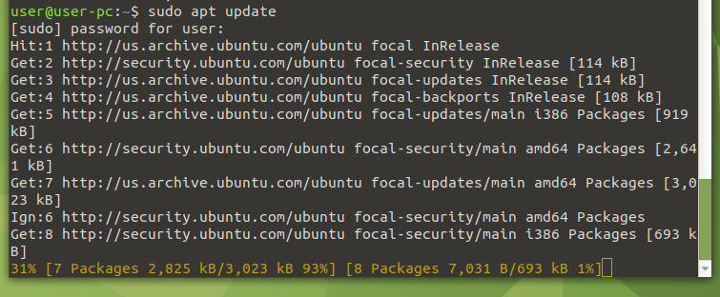
Verify Internet Connectivity from Hosts
Log into your testing hosts and test using ping, a browser, DNS lookup, etc…
If you cannot reach the public Internet, troubleshoot from the host first, then move back towards the Internet Edge
Hosts: verify IP addressing, next-hop gateway, and DNS settings (if testing using a browser or public host names)
Server Leafs: ensure the default route is in the Tenant-1 inet.0 table
Border Leafs: ensure your default route points to the directly-connected ext-rtr node
ext-rtr’s: verify routes have valid next-hops both towards the Internet (default) and towards the hosts (virtual-networks)
WAN_Sim: verify NAT is working and the default next-hop is valid/reachable
Use the eve-ng built-in packet capture to follow the data-path
Remember that you need routes from the fabric to the Internet, and from the WAN_Sim back to the host networks in the fabric.
Test from A-BMS-1 @ 192.168.101.11 on vn101
Test from B-BMS-2 @ 192.168.103.55 on vn103
I was going to show an open browser, but my uMate image is old enough that the SSL ciphers are garbage and Firefox needs to be updated. The host is resolving hostnames and pulling updates, so we’re good!

