Slide 1
Juniper Apstra 4.2.1 EVE-NG Virtual Lab Demo Video series companion guide Video 11: Day-2 Ops scenarios
Colin Doyle, Sr. CE AMER
See the complete video walkthrough on YouTube at: https://www.youtube.com/@5minutejunos
Ask questions at the Juniper Elevate Community using the hashtag #5minutejunos
Adapted from v4.0.0 documentation originally compiled by: - Raymond Lam, SSE APAC - Tony Chan, SSE APAC

Slide 2
Agenda
Prepping your Lab
Day-0 Fabric Onboarding
Virtual Device Profile Verification
Virtual Device Profile Cloning
Onboarding Virtual Nodes
Create ASN Pool and IP Pools
Create Logical Devices and Interface Maps
Create Rack Types
Create Templates
Create Blueprints
Day-1 Service Provisioning
Create Routing Zones
Create Virtual Networks
Assign Virtual Network to Switchports
Add Server Links
Data Center Interconnect
DCI Addendum: Direct Peering
Core/WAN Connectivity
Internet Connectivity
Day-2 Operational Scenarios
Incorrect Cable Patch (RCA, LLDP Link Discovery, Time Voyager)
Config Deviation Checking
Apply custom config through Configlet
View Telemetry Data
Hardware Replacement
Future Documentation
Firewall Service Chaining
Cluster with Service Block
Type-5 Route (fabric integrated) with MNHA
VLAN Stitching
vEvo Fabric

Slide 3
Day-2 Operational Scenarios
Incorrect Cable Patch (RCA, LLDP Link Discovery, Time Voyager)
Config Deviation Checking
Apply custom config through Configlet
View Telemetry Data
Hardware Replacement

Slide 4
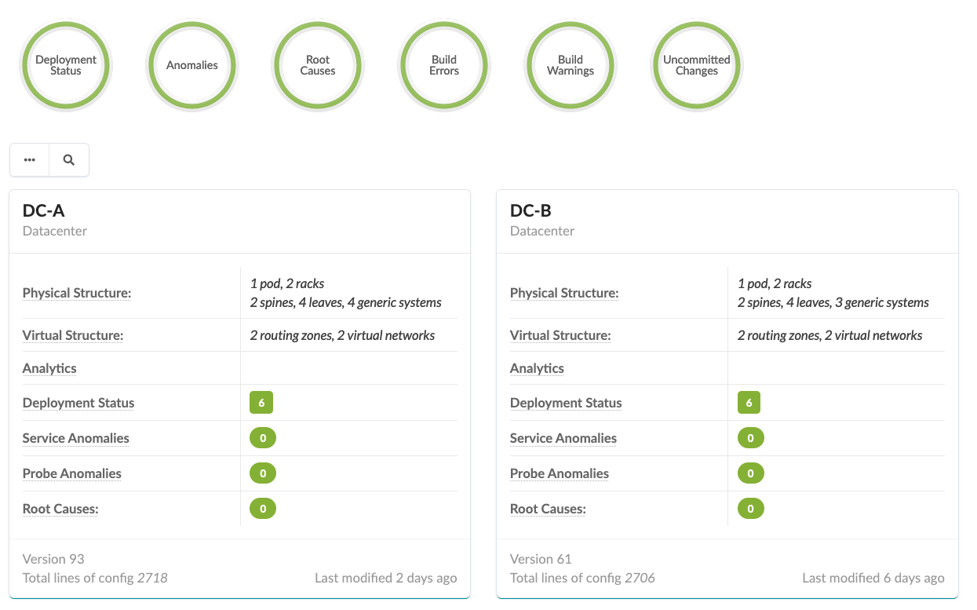
Operational Scenarios
Apstra supports real-time, closed-loop validation to ensure the Intent you define is maintained. Legacy monitoring methods rely on a mix of device logs, telemetry, and an experienced administrator to interpret this information. Apstra continuously compares a complete, simulated fabric to the production fabric, representing any deviations as anomalies. Because Apstra treats the fabric as a gestalt entity, anomalies represent the complete impact of an issue across all devices.
Of course, Apstra still monitors logs and telemetry. Continuous validation of Intent is an evolution of data center troubleshooting, not an alternative.
The following slides will demonstrate some of these capabilities as we modify our lab environment in eve to simulate issues.

Slide 5
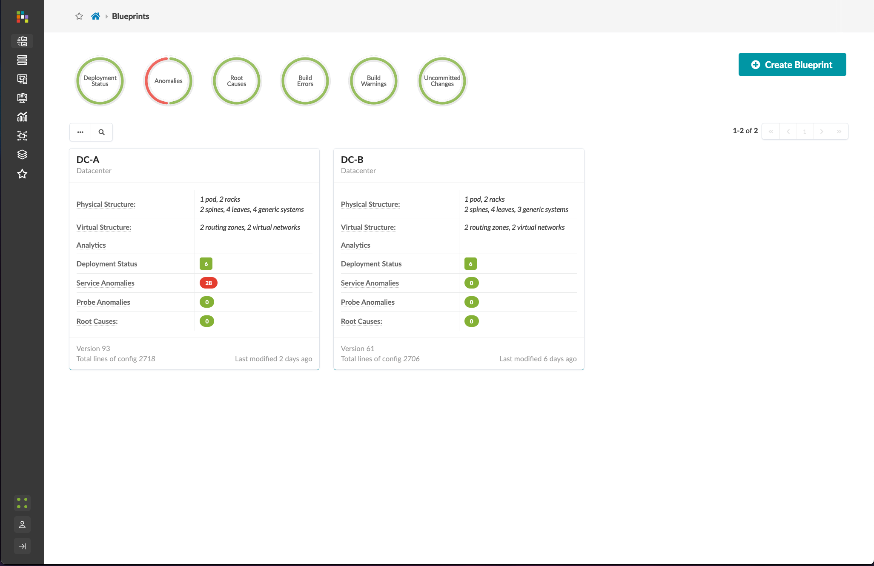
Incorrect Cable Patch - Summary
After a transceiver failure at a colocation, the onsite remote hands have “fixed” the problem. Unfortunately, they somehow managed to put the replacement transceiver into the wrong interface.
To setup our lab, we will add new link between DC-A-leaf1 and DC-A-spine2 and deactivate the existing link. We’ll view and interpret the anomalies this generates, explore our options for resolving the issue, and use Time Voyager to restore our original Intent when finished.

Slide 6
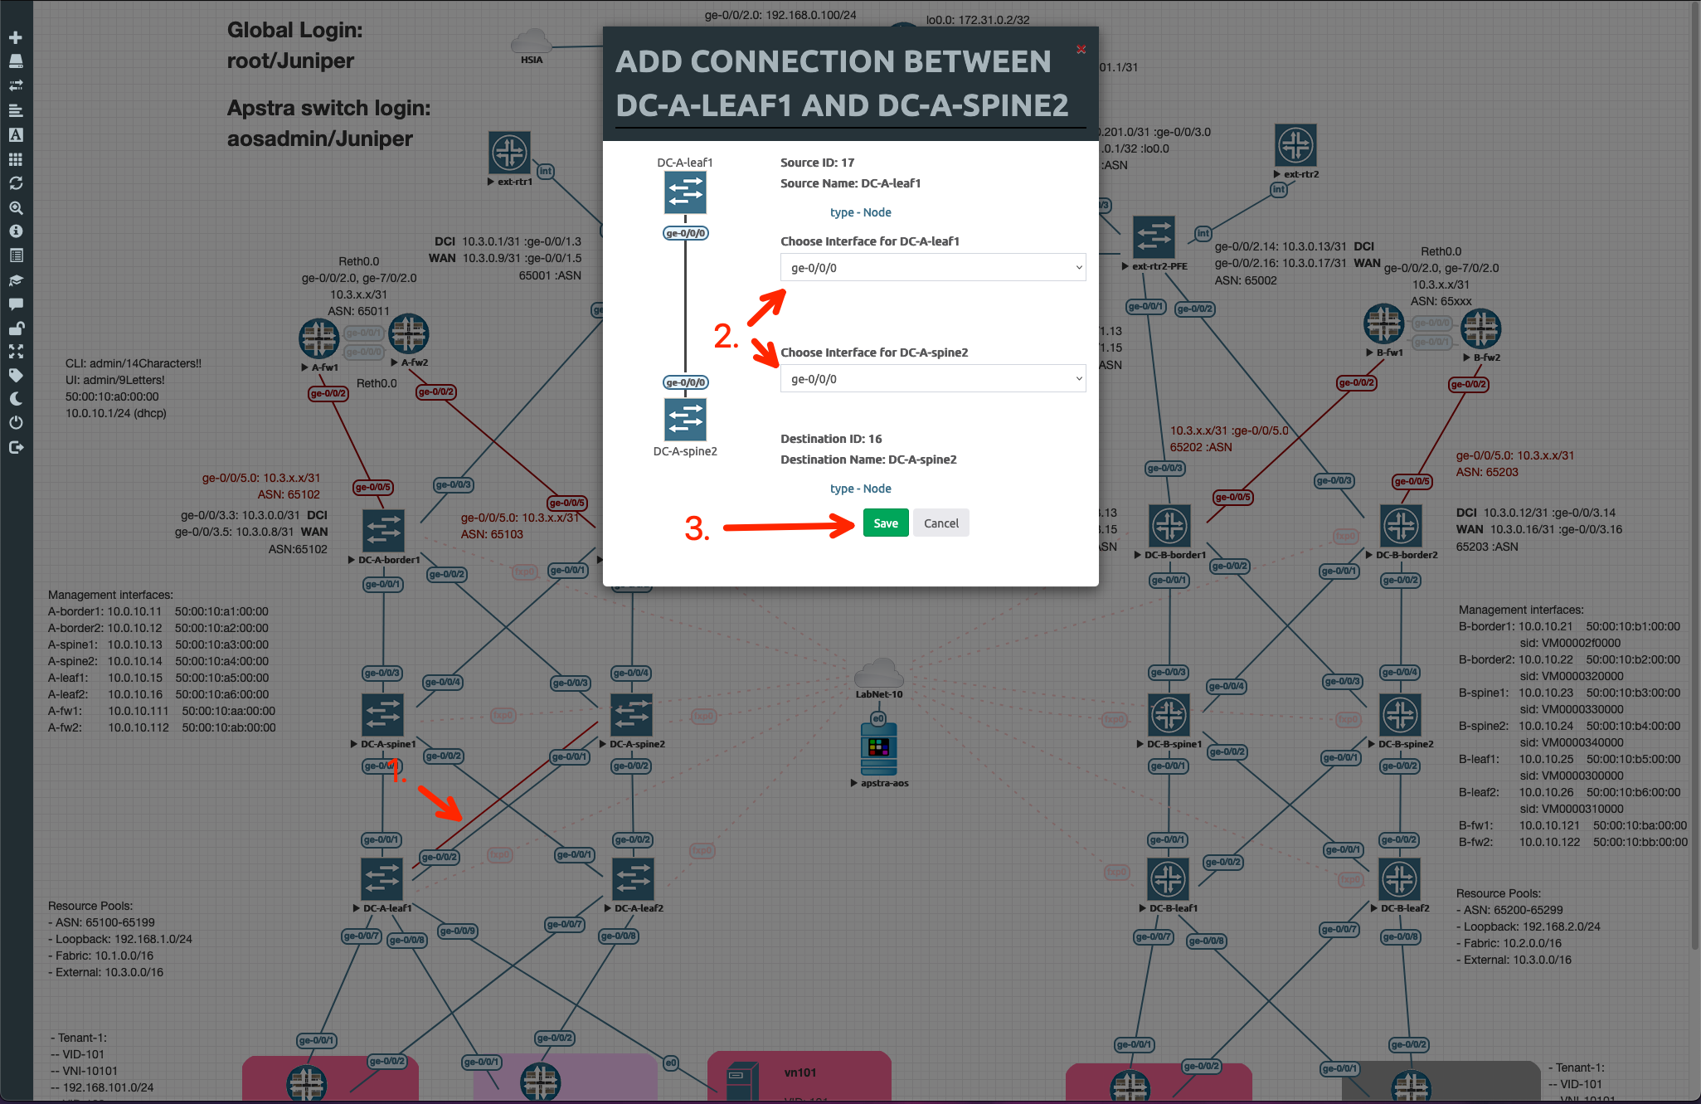
Incorrect Cable Patch – Failure Simulation
In the eve-ng lab topology, create a new link between:
DC-A-leaf1: ge-0/0/0
DC-A-spine2: ge-0/0/0
Suspend the original link by right-clicking one of the interface labels and selecting “Suspend Link”
Verify there is a red dot at either end of the original link

Slide 7
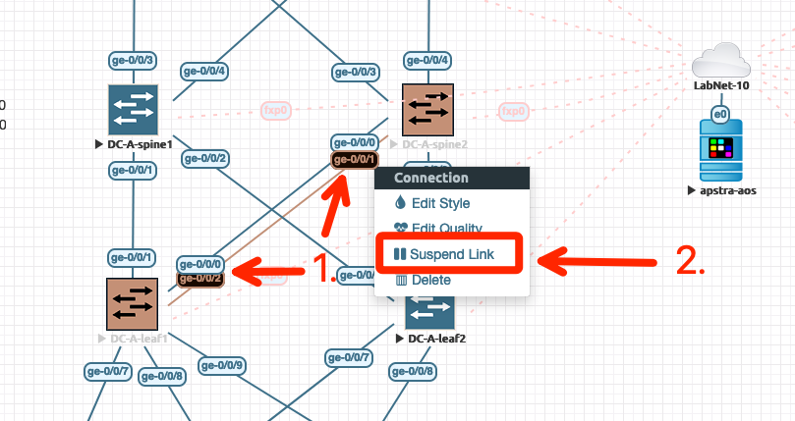
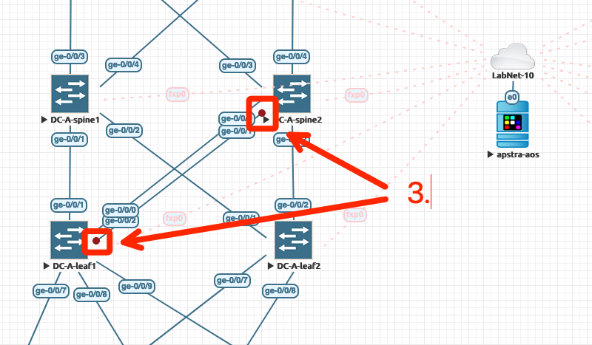
Incorrect Cable Patch – Failure Simulation
In the eve-ng lab topology, create a new link between:
DC-A-leaf1: ge-0/0/0
DC-A-spine2: ge-0/0/0
Suspend the original link by right-clicking one of the interface labels and selecting “Suspend Link”
Verify there is a red dot at either end of the original link

Slide 8
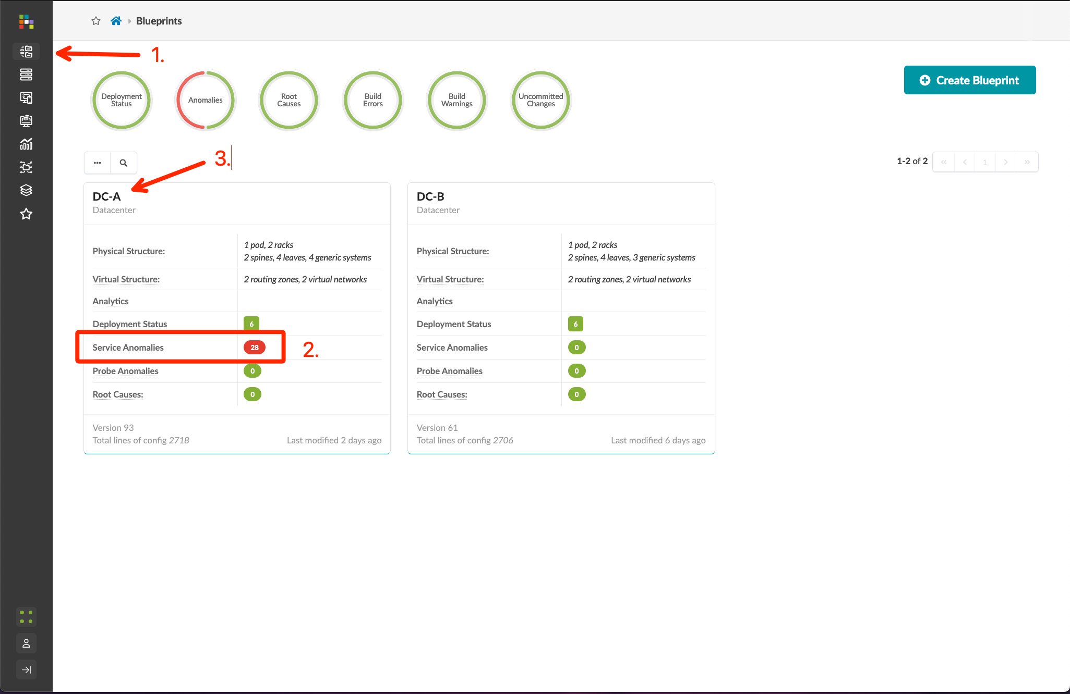
Incorrect Cable Patch – Initial Analysis
Starting from the Blueprints menu, note the Service Anomalies in DC-A, then click the DC-A Blueprint name to open the DC-A Dashboard
The Dashboard has 3 sections – we will use the following 2 sections to troubleshoot our issue:
Anomalies: discrete elements where the production fabric deviates from our defined Intent, sorted into categories
Node Status: a chart that maps anomalies to managed devices, with larger red circles representing a higher number of associated anomalies, and smaller red circles representing fewer associated anomalies
Remembering that troubleshooting starts at Layer-1 and moves towards Layer-7, we start by viewing the Cabling anomalies – if Layer-2 is broken, all higher layers will be impacted

Slide 9
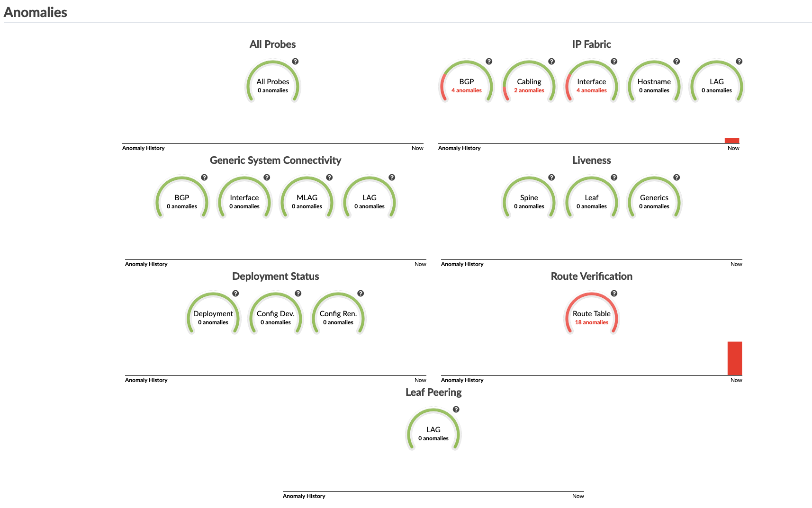
Incorrect Cable Patch – Initial Analysis
Starting from the Blueprints menu, note the Service Anomalies in DC-A, then click the DC-A Blueprint name to open the DC-A Dashboard
The Dashboard has 3 sections – we will use the following 2 sections to troubleshoot our issue:
Anomalies: discrete elements where the production fabric deviates from our defined Intent, sorted into categories
Node Status: a chart that maps anomalies to managed devices, with larger red circles representing a higher number of associated anomalies, and smaller red circles representing fewer associated anomalies
Remembering that troubleshooting starts at Layer-1 and moves towards Layer-7, we start by viewing the Cabling anomalies – if Layer-2 is broken, all higher layers will be impacted

Slide 10
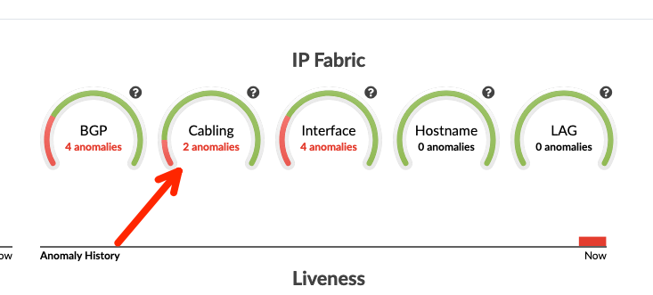
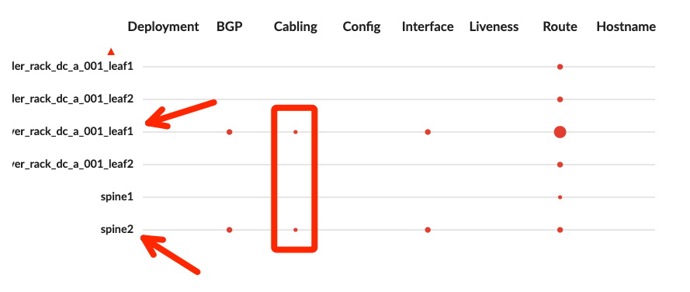
Incorrect Cable Patch – Initial Analysis
Starting from the Blueprints menu, note the Service Anomalies in DC-A, then click the DC-A Blueprint name to open the DC-A Dashboard
The Dashboard has 3 sections – we will use the following 2 sections to troubleshoot our issue:
Anomalies: discrete elements where the production fabric deviates from our defined Intent, sorted into categories
Node Status: a chart that maps anomalies to managed devices, with larger red circles representing a higher number of associated anomalies, and smaller red circles representing fewer associated anomalies
Remembering that troubleshooting starts at Layer-1 and moves towards Layer-7, we start by viewing the Cabling anomalies – if Layer-2 is broken, all higher layers will be impacted
Note that without even clicking into anything, we can already diagnose the issue as cabling between Leaf1 and Spine2 based on the Node Status chart!

Slide 11
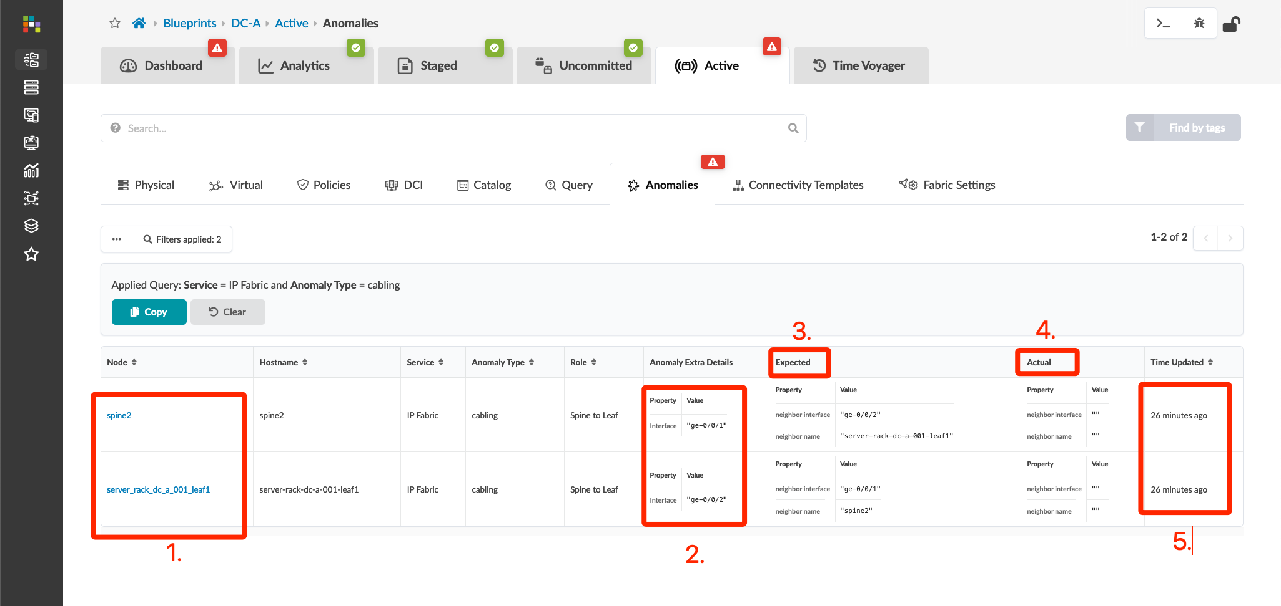
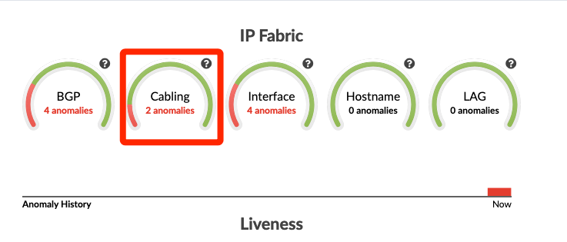
Incorrect Cable Patch – Exploring the Data
We know that we have a cabling issue between Leaf1 and Spine2 based on the Node Status chart. Before we resolve the issue, let’s look at the ways we can drill down into the data from the dashboard…
Clicking the Cabling anomaly opens the live view in the Active fabric tab
From here, we see:
Impacted nodes
The interface names that are impacted
What is defined in the Intent
What is being reported by the production fabric
How much time has passed since the anomaly was first reported

Slide 12
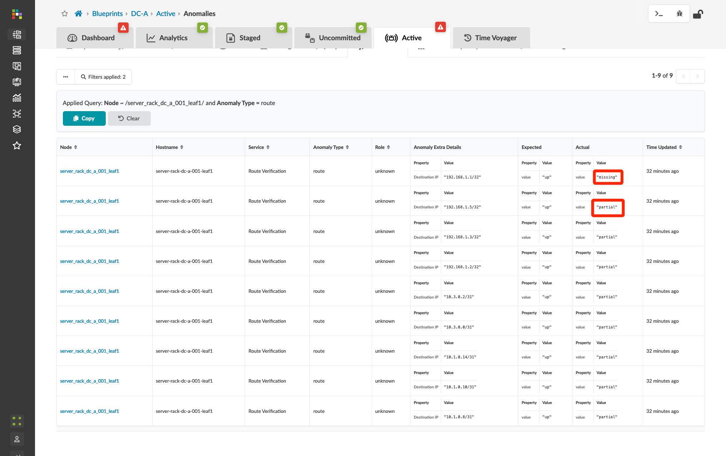
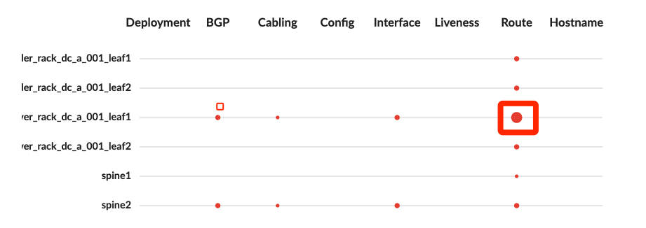
Incorrect Cable Patch – Exploring the Data
We know that we have a cabling issue between Leaf1 and Spine2 based on the Node Status chart. Before we resolve the issue, let’s look at the ways we can drill down into the data from the dashboard…
Clicking the big red circle in the Node Status opens the live view of the Route anomaly in the active fabric tab.
Because Apstra is simulating the fabric, it is aware of every route in every route table on every managed device. Note that this level of granularity allows Apstra to not only identify when, where, and what routes are missing – it can tell you if a route exists in a table but is missing one or more expected next-hops!
Consider how long it would take to discover this sort of information using legacy tools…

Slide 13
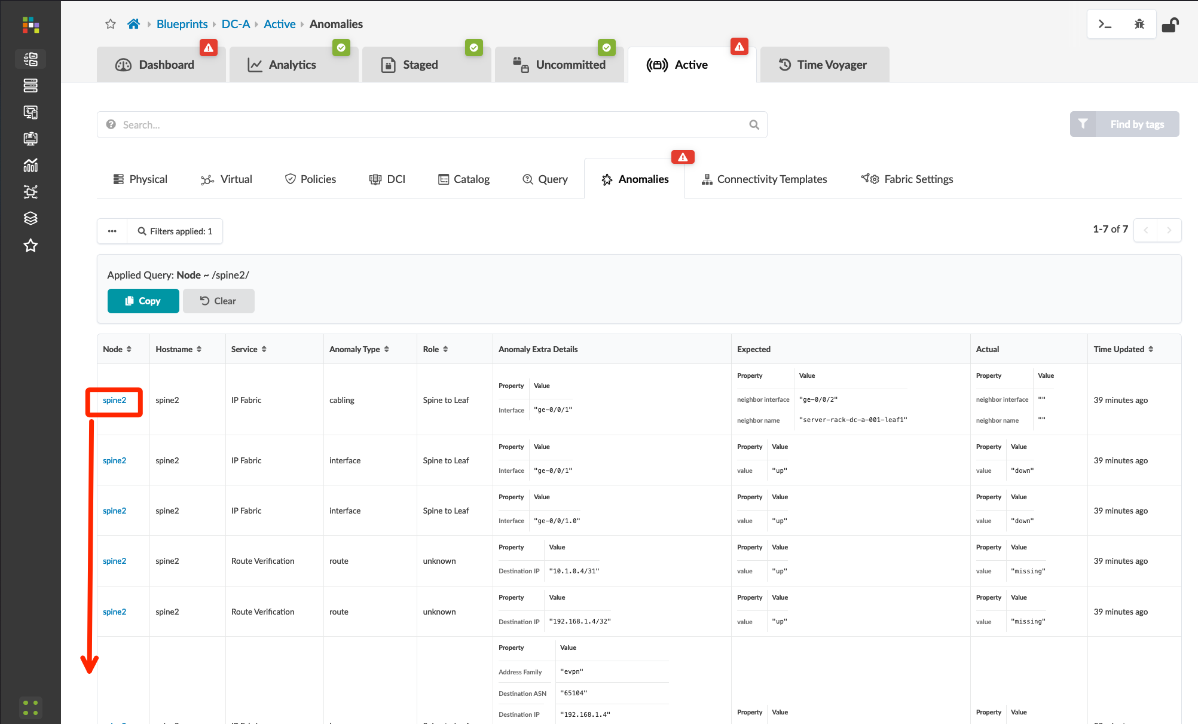
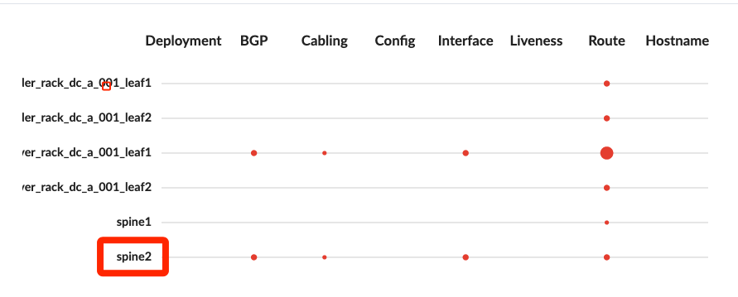
Incorrect Cable Patch – Exploring the Data
We know that we have a cabling issue between Leaf1 and Spine2 based on the Node Status chart. Before we resolve the issue, let’s look at the ways we can drill down into the data from the dashboard…
Clicking the node name in the Node Status opens the live node view of anomalies in the active fabric tab.
Here we can see all of the anomalies impacting this specific node in the fabric.

Slide 14
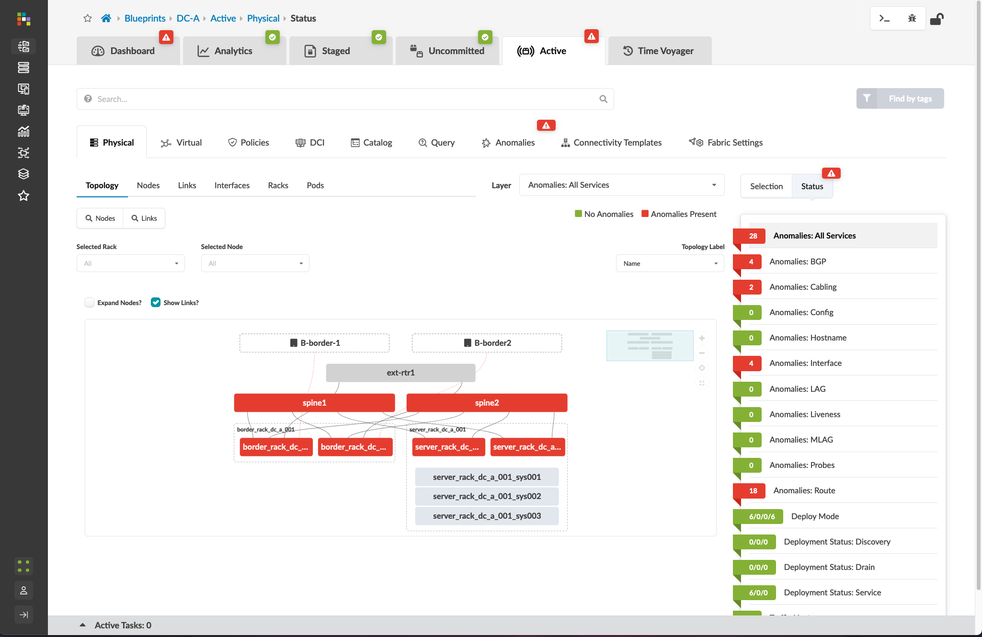
Incorrect Cable Patch – Exploring the Data
Alternately, we can view anomalies directly from the Active tab.
Systems impacted by anomalies are red. The default status view shows all impacted services across all switches. Because our cable issue is impacting peering and route tables, all nodes appear red.
Click on the “Anomalies: Cabling” element to reduce the scope of the anomaly association. You’ll note that only spine2 and server_rack_dc_a_001_leaf1 are now red.
Click the “spine2” node.
The issue is clearly visible in the topology view for spine2. We see that ge-0/0/1 is down and the dotted red line shows what remote link is also impacted.

Slide 15
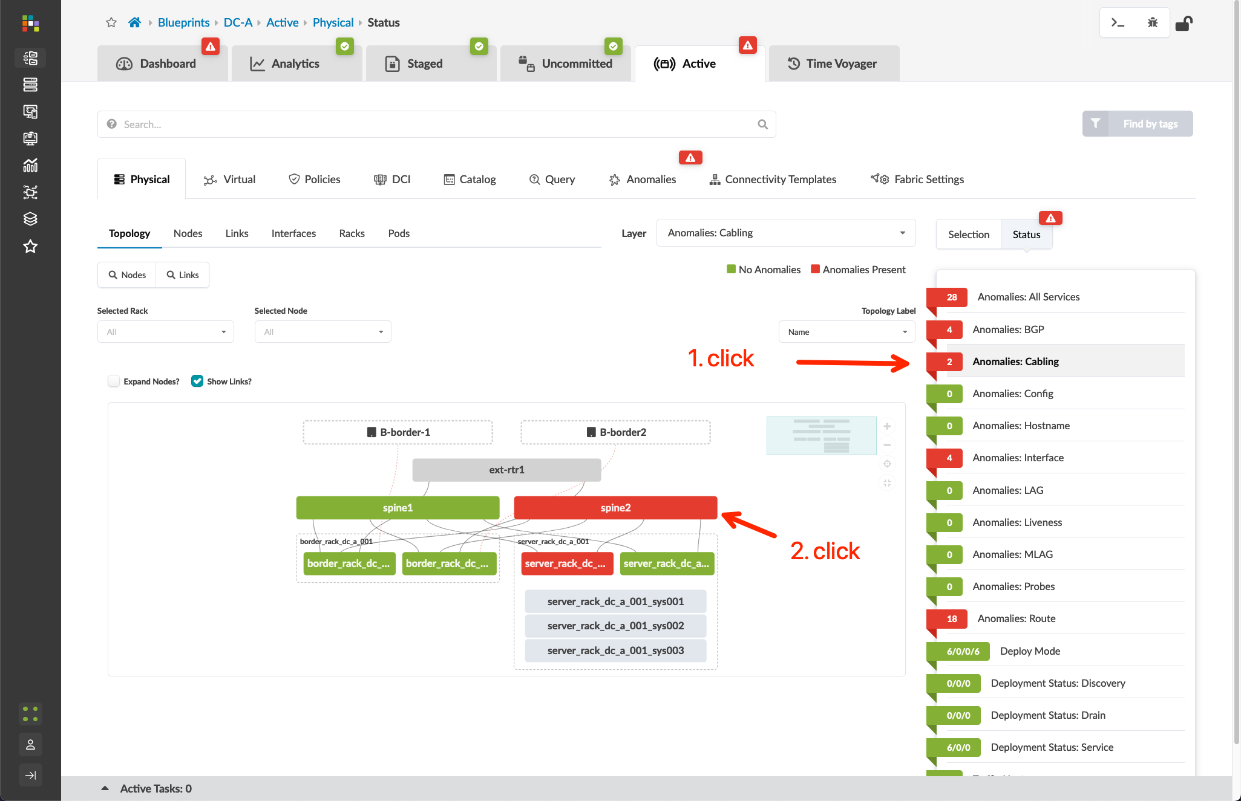
Incorrect Cable Patch – Exploring the Data
Alternately, we can view anomalies directly from the Active tab.
Systems impacted by anomalies are red. The default status view shows all impacted services across all switches. Because our cable issue is impacting peering and route tables, all nodes appear red.
Click on the “Anomalies: Cabling” element to reduce the scope of the anomaly association. You’ll note that only spine2 and server_rack_dc_a_001_leaf1 are now red.
Click the “spine2” node
The issue is clearly visible in the topology view for spine2. We see that ge-0/0/1 is down and the dotted red line shows what remote link is also impacted.

Slide 16
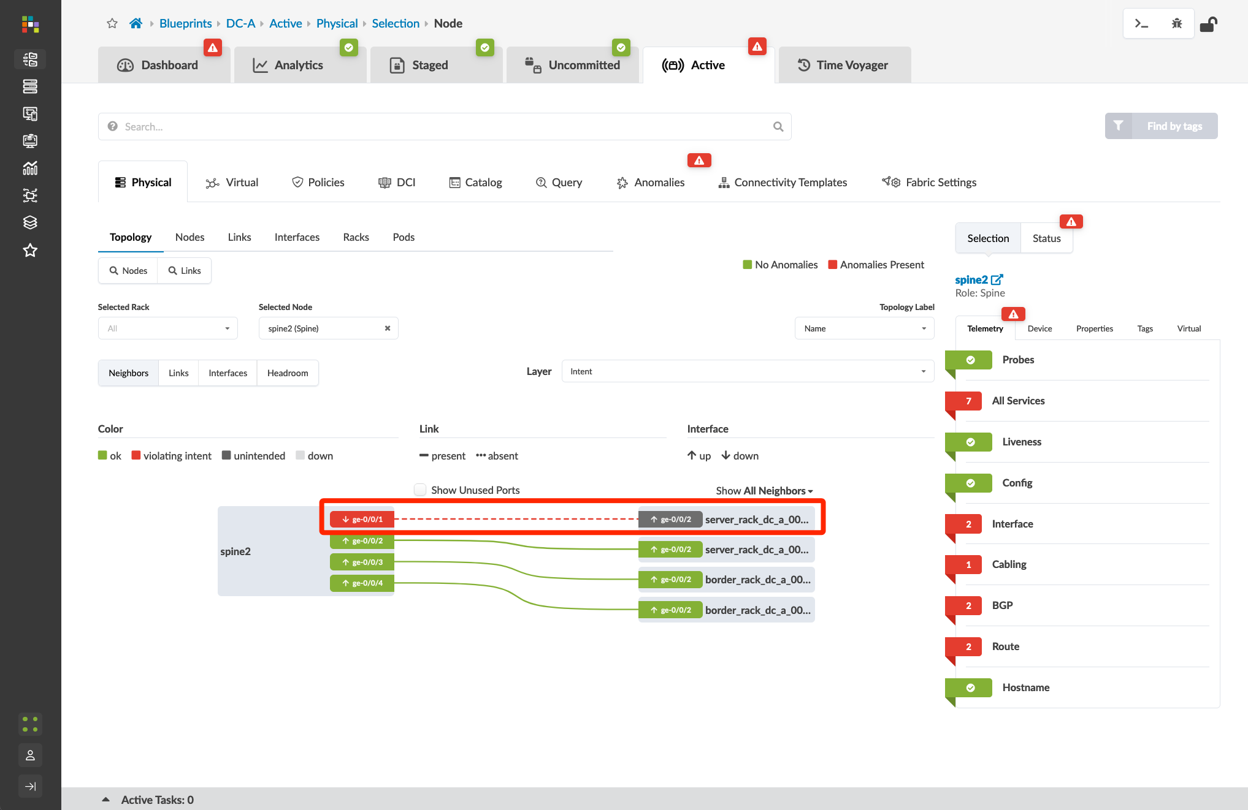
Incorrect Cable Patch – Exploring the Data
Alternately, we can view anomalies directly from the Active tab.
Systems impacted by anomalies are red. The default status view shows all impacted services across all switches. Because our cable issue is impacting peering and route tables, all nodes appear red.
Click on the “Anomalies: Cabling” element to reduce the scope of the anomaly association. You’ll note that only spine2 and server_rack_dc_a_001_leaf1 are now red.
Click the “spine2” node.
The issue is clearly visible in the topology view for spine2. We see that ge-0/0/1 is down and the dotted red line shows what remote link is also impacted.

Slide 17
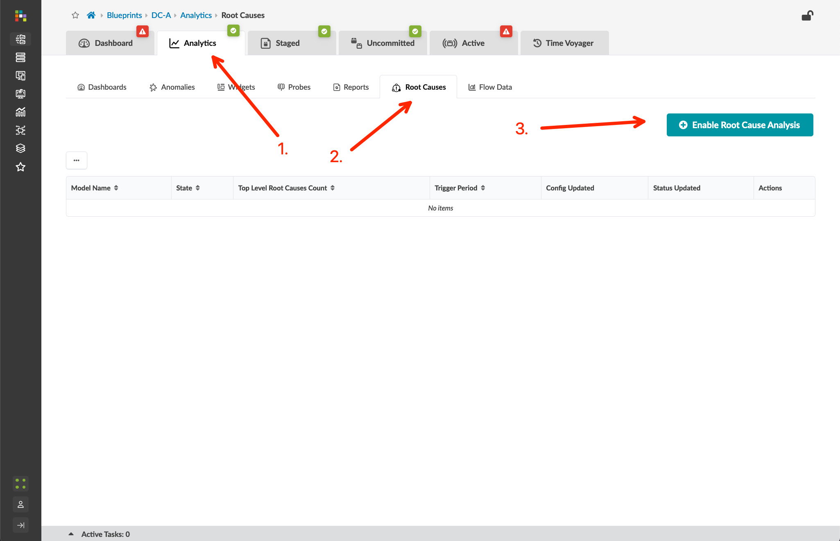
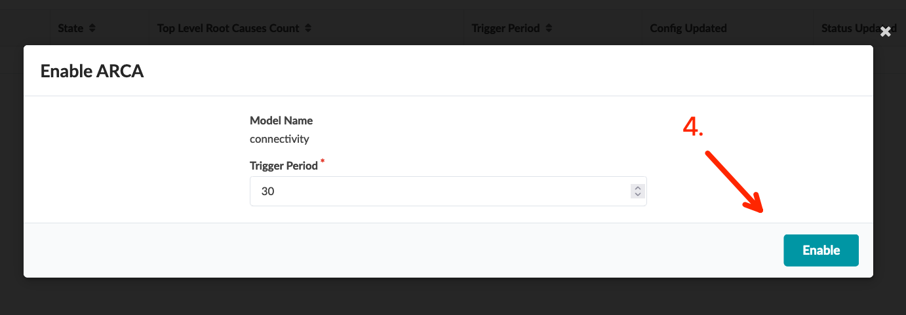
Incorrect Cable Patch – Root Cause Analysis
Root Cause Identification (RCI) is an Apstra feature that can automatically determine root causes of complex network issues. It uses the GraphDB datastore associated with a blueprint for real time network status, and automatically correlates this telemetry information with each active blueprint intent.
We’ll start by enabling RCI from the Analytics tab in DC-A.
Now click the “connectivity” Model Name. This will bring up the Root Causes view.
The default Topology View will show you the switches impacted by the connectivity root-cause identified by Apstra.
The Tabular View provides a human-readable explanation of the root cause. Note the inclusion of clickable links for each listed symptom. Clicking these will take you to the associated node view.
Neat!

Slide 18
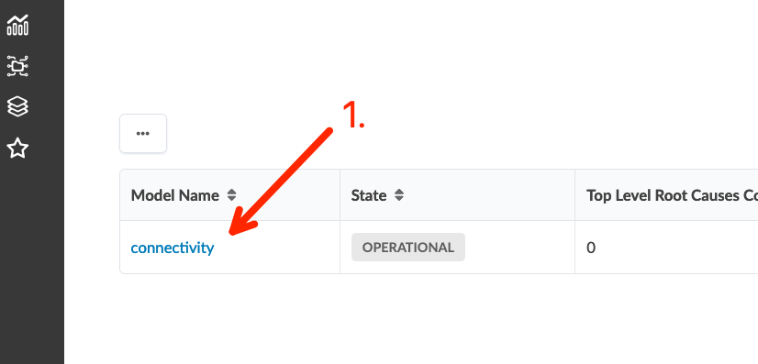
Incorrect Cable Patch – Root Cause Analysis
Root Cause Identification (RCI) is an Apstra feature that can automatically determine root causes of complex network issues. It uses the GraphDB datastore associated with a blueprint for real time network status, and automatically correlates this telemetry information with each active blueprint intent.
We’ll start by enabling RCI from the Analytics tab in DC-A.
Now click the “connectivity” Model Name. This will bring up the Root Causes view.
The default Topology View will show you the switches impacted by the connectivity root-cause identified by Apstra.
The Tabular View provides a human-readable explanation of the root cause. Note the inclusion of clickable links for each listed symptom. Clicking these will take you to the associated node view.
Neat!

Slide 19
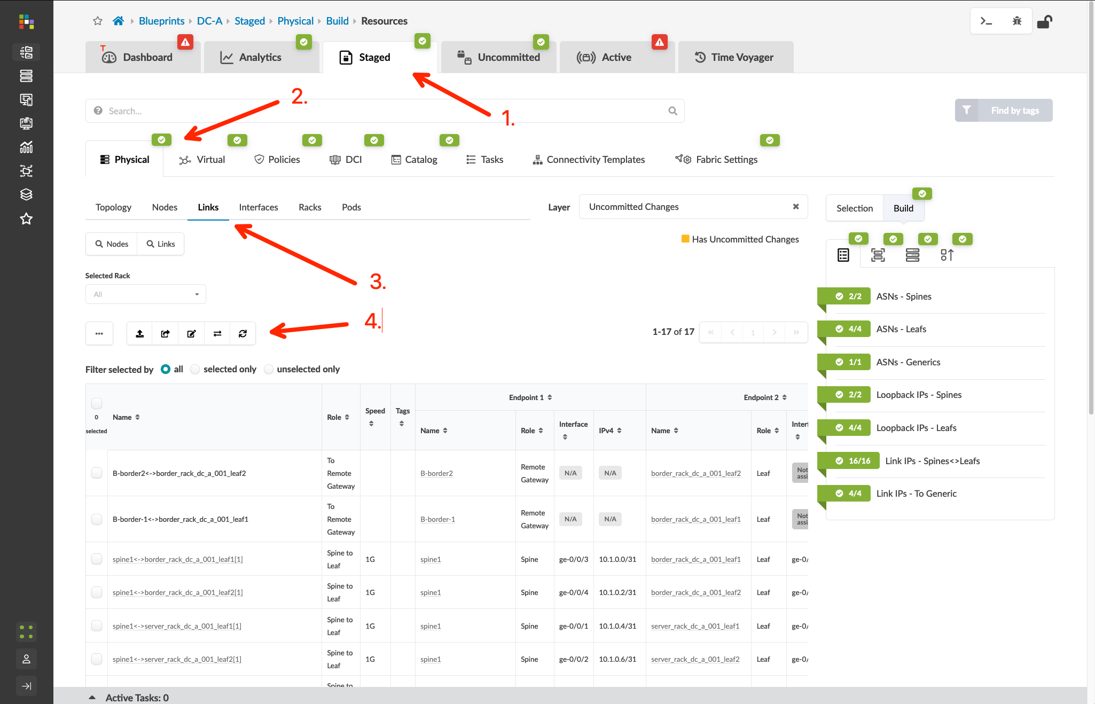
Incorrect Cable Patch – Two Paths to Resolution
Path 1 – Update the Intent to reflect the new link between leaf1 and spine2
Navigate to DC-A > Staged > Physical > Links and click the “Fetch Discovered LLDP Data” button
You’ll see a message indicating Apstra has detected an LLDP neighbor relationship between two fabric nodes that differs from the user-defined Intent
Click the “Update Cabling Map from LLDP” button to open the Cabling Map Editor – Apstra has detected the new link!
From here you can click “Update” to reconfigure the Intent for the new link between leaf1 and spine2
Commit the Blueprint to push the updated Intent to the fabric
Path 2 – In your eve-ng topology, delete the new link, resume the original link, and wait for your DC-A anomalies to clear This is the method I will use to restore our lab to the original design

Slide 20
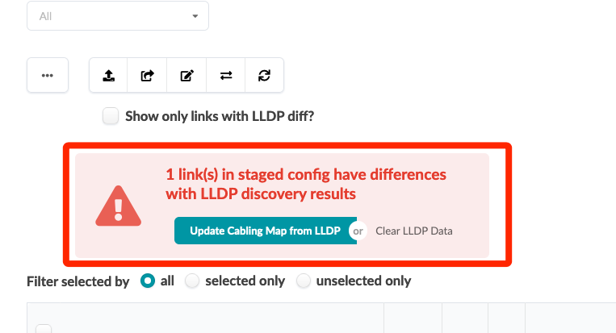
Incorrect Cable Patch – Two Paths to Resolution
Path 1 – Update the Intent to reflect the new link between leaf1 and spine2
Navigate to DC-A > Staged > Physical > Links and click the “Fetch Discovered LLDP Data” button
You’ll see a message indicating Apstra has detected an LLDP neighbor relationship between two fabric nodes that differs from the user-defined Intent
Click the “Update Cabling Map from LLDP” button to open the Cabling Map Editor – Apstra has detected the new link!
From here you can click “Update” to reconfigure the Intent for the new link between leaf1 and spine2
Commit the Blueprint to push the updated Intent to the fabric
Path 2 – In your eve-ng topology, delete the new link, resume the original link, and wait for your DC-A anomalies to clear This is the method I will use to restore our lab to the original design

Slide 21
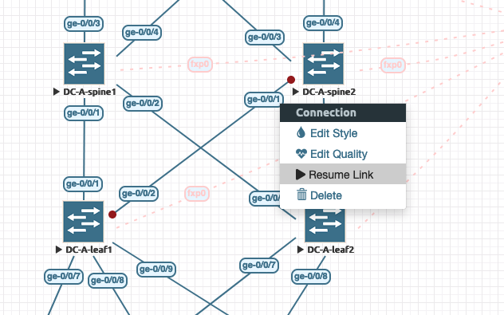
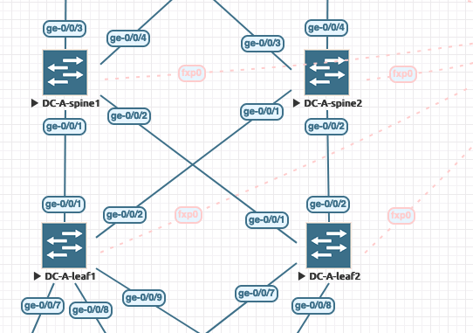
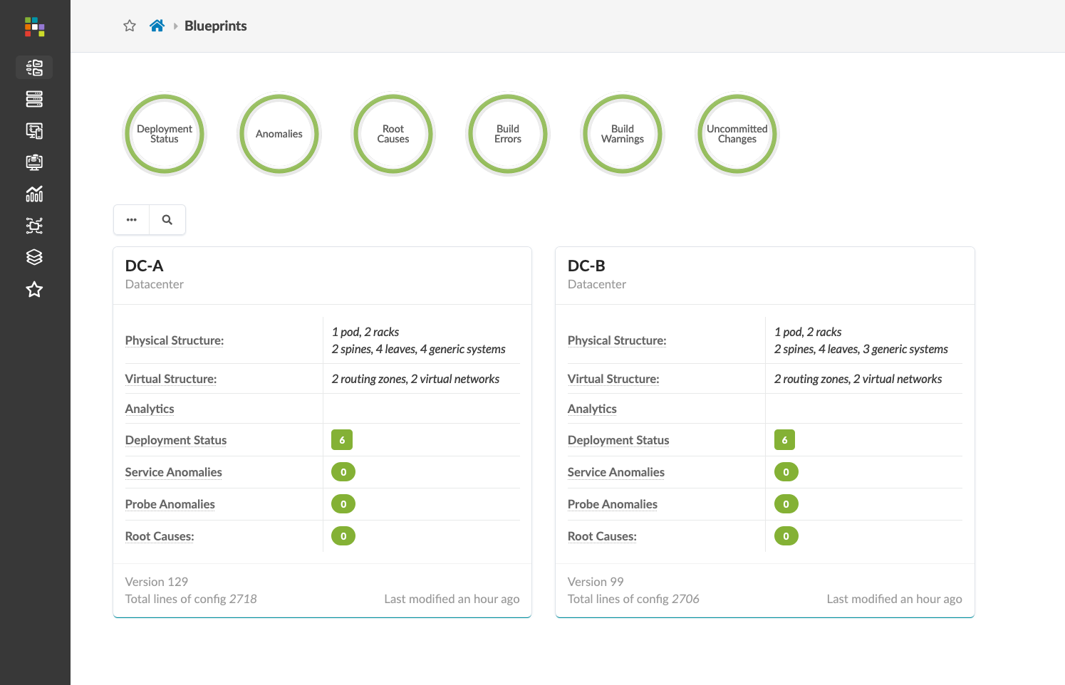
Incorrect Cable Patch – Two Paths to Resolution
Path 1 – Update the Intent to reflect the new link between leaf1 and spine2
Navigate to DC-A > Staged > Physical > Links and click the “Fetch Discovered LLDP Data” button
You’ll see a message indicating Apstra has detected an LLDP neighbor relationship between two fabric nodes that differs from the user-defined Intent
Click the “Update Cabling Map from LLDP” button to open the Cabling Map Editor – Apstra has detected the new link!
From here you can click “Update” to reconfigure the Intent for the new link between leaf1 and spine2
Commit the Blueprint to push the updated Intent to the fabric
Path 2 – In your eve-ng topology, delete the new link, resume the original link, and wait for your DC-A anomalies to clear This is the method I will use to restore our lab to the original design

Slide 22
Config Deviation Checking
Apstra can monitor the configuration of each device and validate it against the rendered config based on our intent. If a configuration has been modified manually, Apstra will generate a config deviation anomaly to alert the operator of the changes.
The operator can choose to accept the changes or revert to the existing Intent.

Slide 23
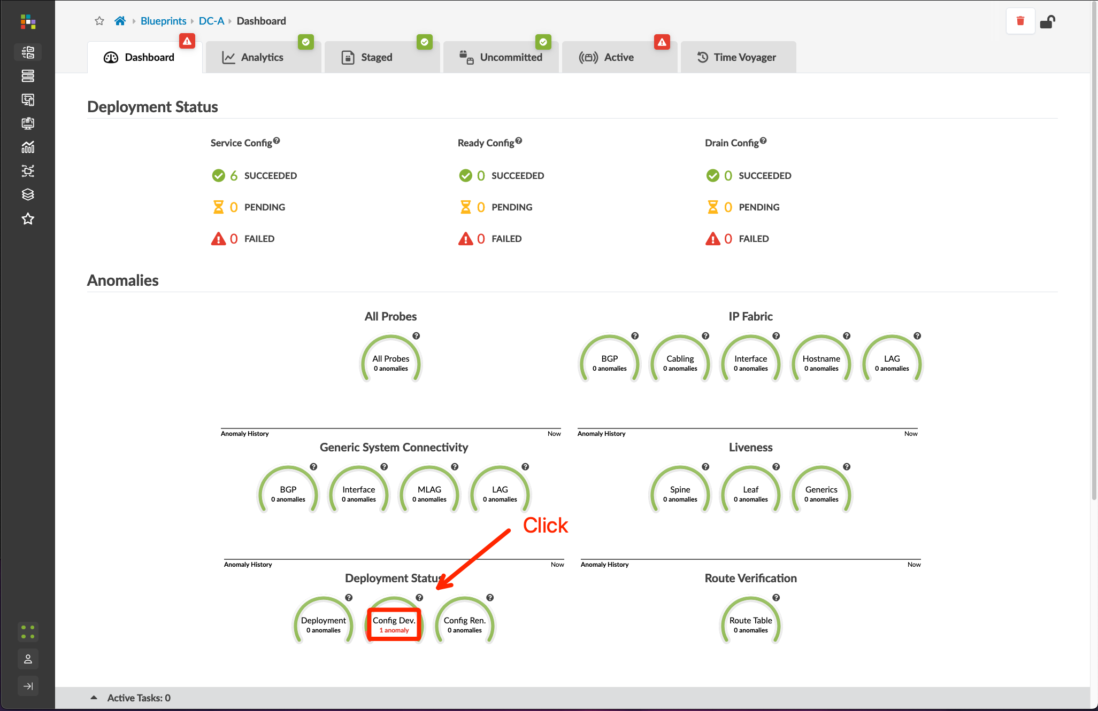
Config Deviation Checking
Login to A-spine1 and configure a NTP server set system ntp server 172.27.171.253 routing-instance mgmt_junos commit and-quit
Go to Blueprints > DC-A > Dashboard, wait for 1-2 minutes, and you should be able to see the Config Dev. anomaly as shown in the screenshot – Click the “Config Dev.” anomaly
Go to Blueprints > DC-A > Active > Anomalies, select spine1, and click to view its info
Scroll down to view the config deviation, click “Accept Changes”, and the anomaly will clear as the Intent is updated
①
1 Config Dev. anomaly

Slide 24
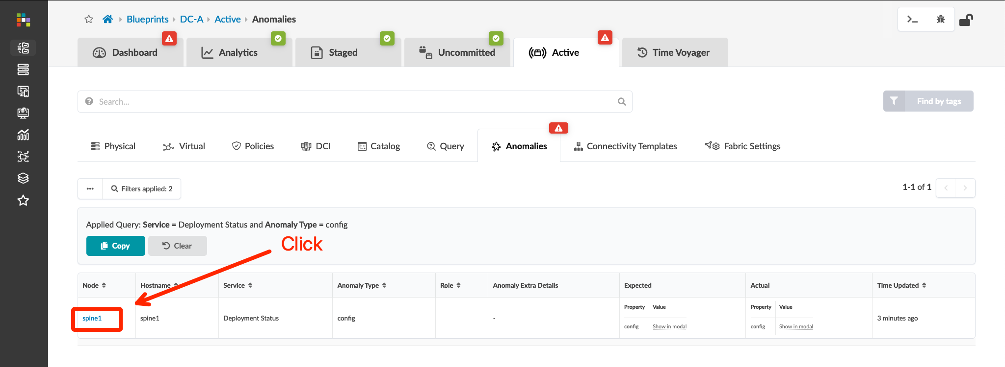
Config Deviation Checking
Login to A-spine1 and configure a NTP server set system ntp server 172.27.171.253 routing-instance mgmt_junos commit and-quit
Go to Blueprints > DC-A > Dashboard, wait for 1-2 minutes, and you should be able to see the Config Dev. anomaly as shown in the screenshot – Click the “Config Dev.” anomaly
Go to Blueprints > DC-A > Active > Anomalies, select spine1, and click to view its info
Scroll down to view the config deviation, click “Accept Changes”, and the anomaly will clear as the Intent is updated

Slide 25
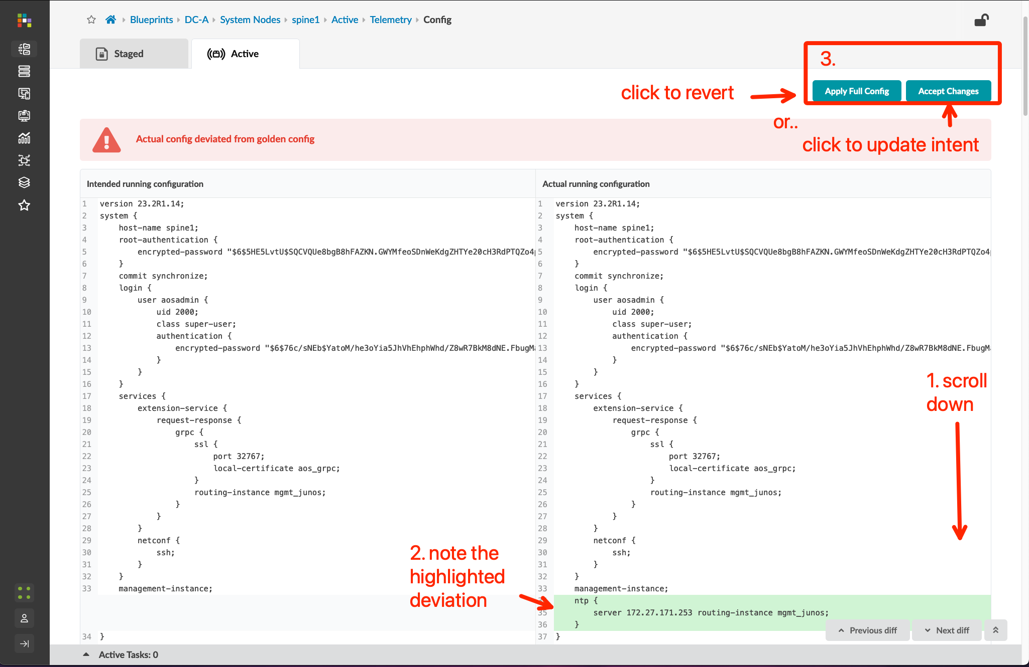
Config Deviation Checking
Login to A-spine1 and configure a NTP server set system ntp server 172.27.171.253 routing-instance mgmt_junos commit and-quit
Go to Blueprints > DC-A > Dashboard, wait for 1-2 minutes, and you should be able to see the Config Dev. anomaly as shown in the screenshot – Click the “Config Dev.” anomaly
Go to Blueprints > DC-A > Active > Anomalies, select spine1, and click to view its info
Scroll down to view the config deviation, click “Accept Changes”, and the anomaly will clear as the Intent is updated

Slide 26
Apply custom config through Configlet
In the previous section, we manually configured an NTP server on a spine switch using the CLI and accepted this change in Apstra to clear the Config Dev. anomaly.
This is not the recommended workflow for configuration changes that exist outside of the fabric Intent.
The recommended workflow to apply custom configuration elements is through a Configlet. Configuration in a Configlet is added to the rendered configuration pushed by Apstra. This ensures that the configuration is not overwritten by an Apstra configuration push (specifically a “Full” configuration push). This also allows an operator to render custom configuration to a group of devices based on an labels and/or meta data.

Slide 27
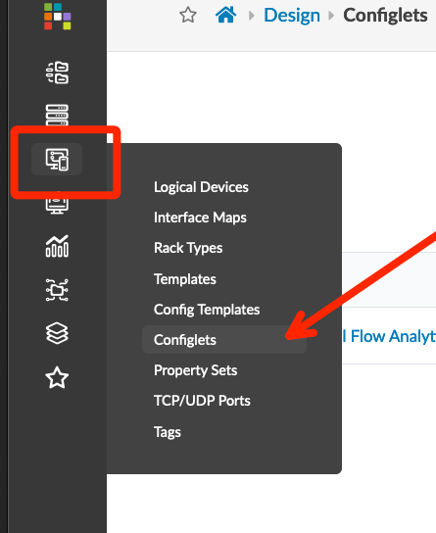
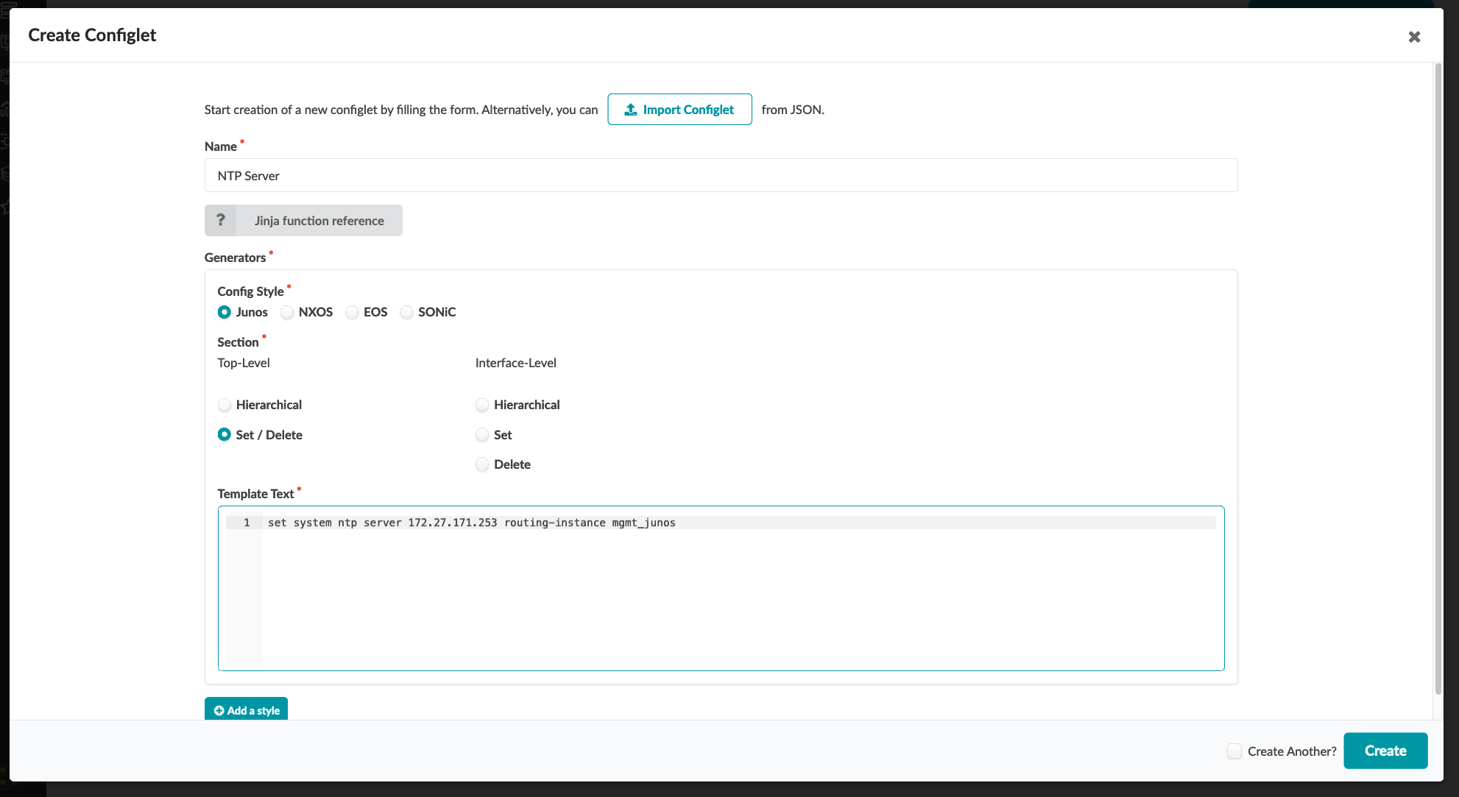
Apply custom config through Configlet
Go to Design > Configlets and create a new Configlet object. You can use either Hierarchical or Set/Delete formats – an example of both is provided below:
Go to Blueprints > DC-A > Staged > Catalog > Configlets and import the NTP server Configlet
Commit the Blueprint
Verify that NTP configuration has been pushed to all switches in DC-A
Name | NTP server
Config Style | Junos
Section | Top-Level
Hierarchical | system { ntp { server 172.27.171.253 routing-instance mgmt_junos; } }
Set / Delete | set system ntp server 172.27.171.253 routing-instance mgmt_junos

Slide 28
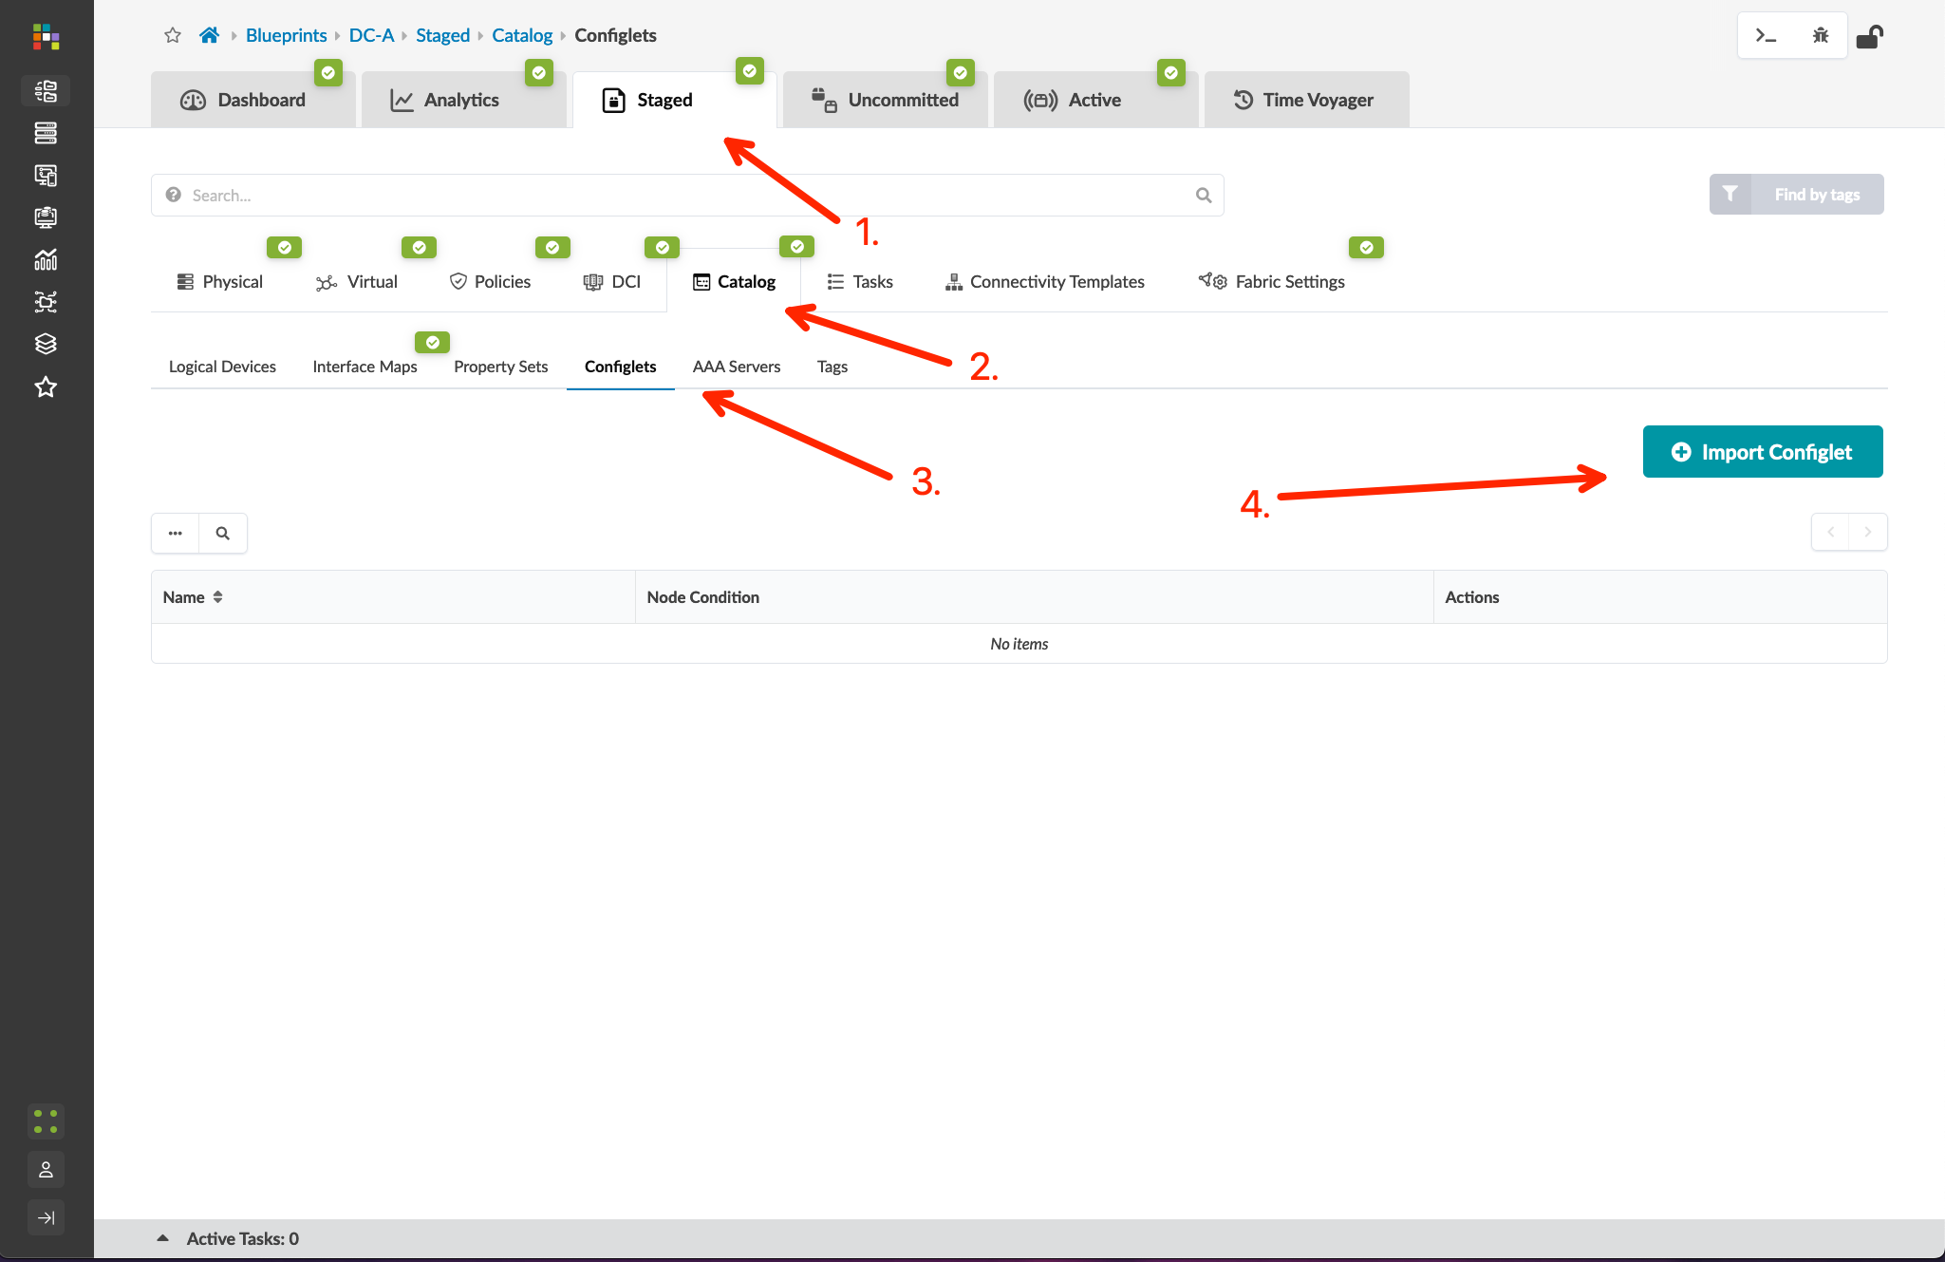
Apply custom config through Configlet
Go to Design > Configlets and create a new Configlet object. You can use either Hierarchical or Set/Delete formats – an example of both is provided below:
Go to Blueprints > DC-A > Staged > Catalog > Configlets and import the NTP server Configlet
Commit the Blueprint
Verify that NTP configuration has been pushed to all switches in DC-A
Name | NTP server
Config Style | Junos
Section | Top-Level
Hierarchical | system { ntp { server 172.27.171.253 routing-instance mgmt_junos; } }
Set / Delete | set system ntp server 172.27.171.253 routing-instance mgmt_junos

Slide 29
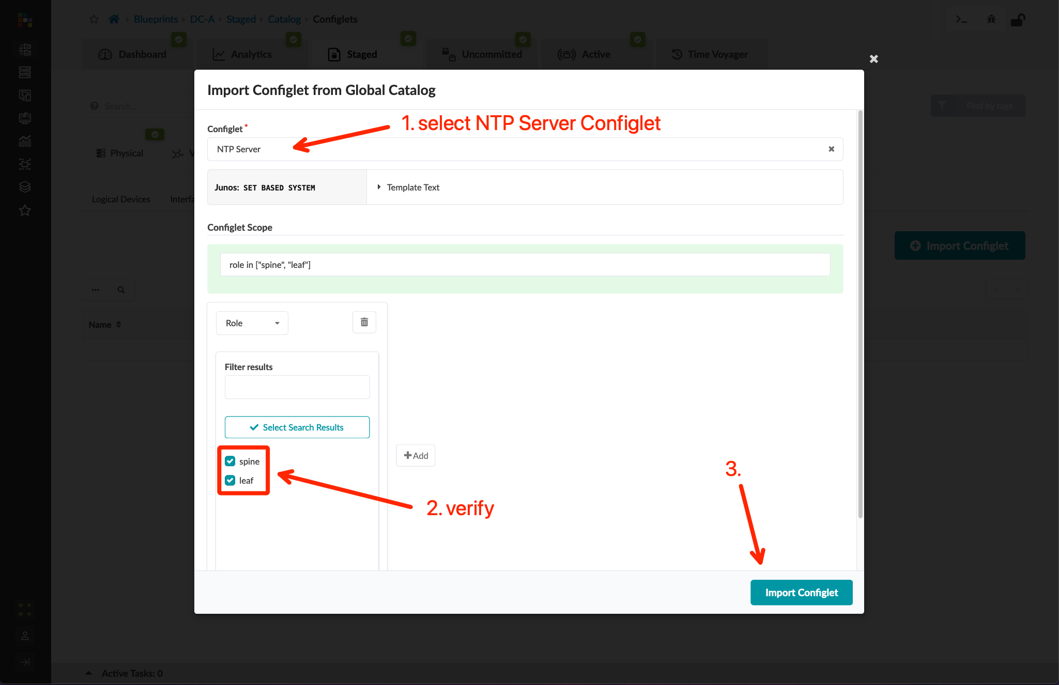
Apply custom config through Configlet
Go to Design > Configlets and create a new Configlet object. You can use either Hierarchical or Set/Delete formats – an example of both is provided below:
Go to Blueprints > DC-A > Staged > Catalog > Configlets and import the NTP server Configlet
Commit the Blueprint
Verify that NTP configuration has been pushed to all switches in DC-A
Name | NTP server
Config Style | Junos
Section | Top-Level
Hierarchical | system { ntp { server 172.27.171.253 routing-instance mgmt_junos; } }
Set / Delete | set system ntp server 172.27.171.253 routing-instance mgmt_junos

Slide 30
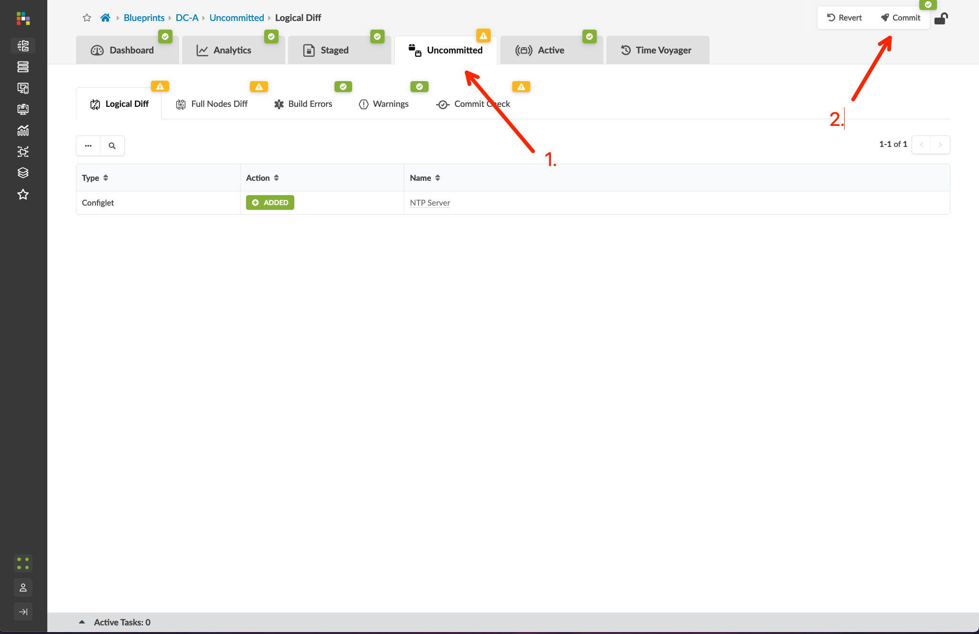
Apply custom config through Configlet
Go to Design > Configlets and create a new Configlet object. You can use either Hierarchical or Set/Delete formats – an example of both is provided below:
Go to Blueprints > DC-A > Staged > Catalog > Configlets and import the NTP server Configlet
Commit the Blueprint
Verify that NTP configuration has been pushed to all switches in DC-A
Name | NTP server
Config Style | Junos
Section | Top-Level
Hierarchical | system { ntp { server 172.27.171.253 routing-instance mgmt_junos; } }
Set / Delete | set system ntp server 172.27.171.253 routing-instance mgmt_junos

Slide 31
View Telemetry Data
Apstra provides graphical and test-based access to an enormous amount of telemetry data. This section explores the following practical, operational telemetry tasks:
Search end hosts by MAC
Search end hosts by IP address
Display interface statistics
Check the operational information of a device

Slide 32
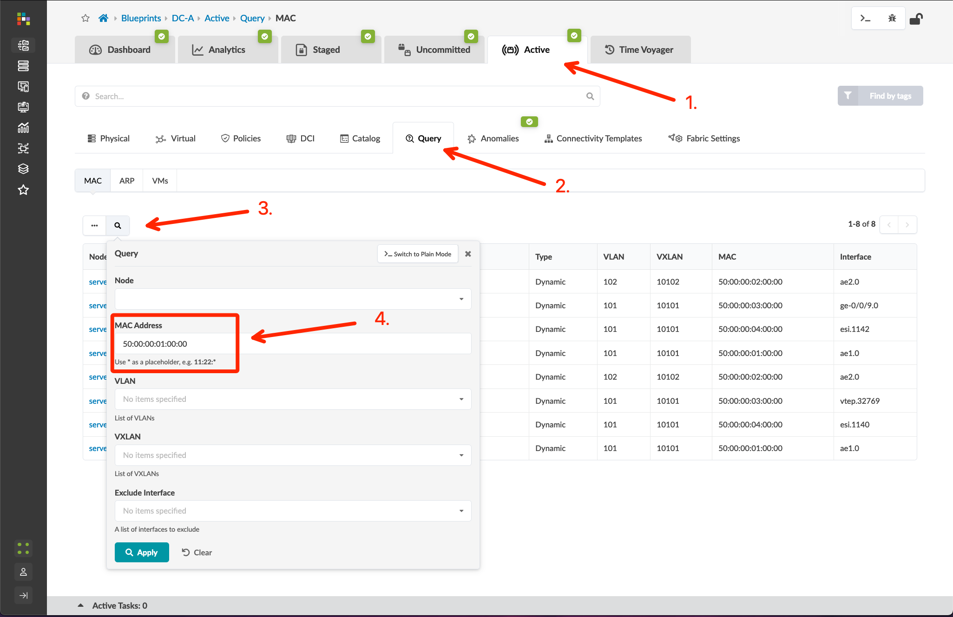
View Telemetry Data
Go to Blueprints > DC-A > Active > Query > MAC, click the “Search” box and input the MAC of a connected BMS testing node to view the fabric nodes the host is connected to
MAC info for a running node can be viewed by right-clicking the node in the eve-ng lab and selecting “Details” from the menu. Assuming you have deployed your testing nodes with a single Ethernet interface, the MAC address in the “First Eth MAC Address” field should be correct.
Go to Blueprints > DC-A > Active > Query > ARP, click the “Query” box, and input filter criteria – Apstra will display the filtered ARP table in the Blueprint
Go to Blueprints > DC-A > Active > Physical, choose a device, and view the interface counters
Go to Blueprints > DC-A > Staged > Physical, select one device, and open its information page
In the Telemetry page, click the tabs to explore some of the available information

Slide 33
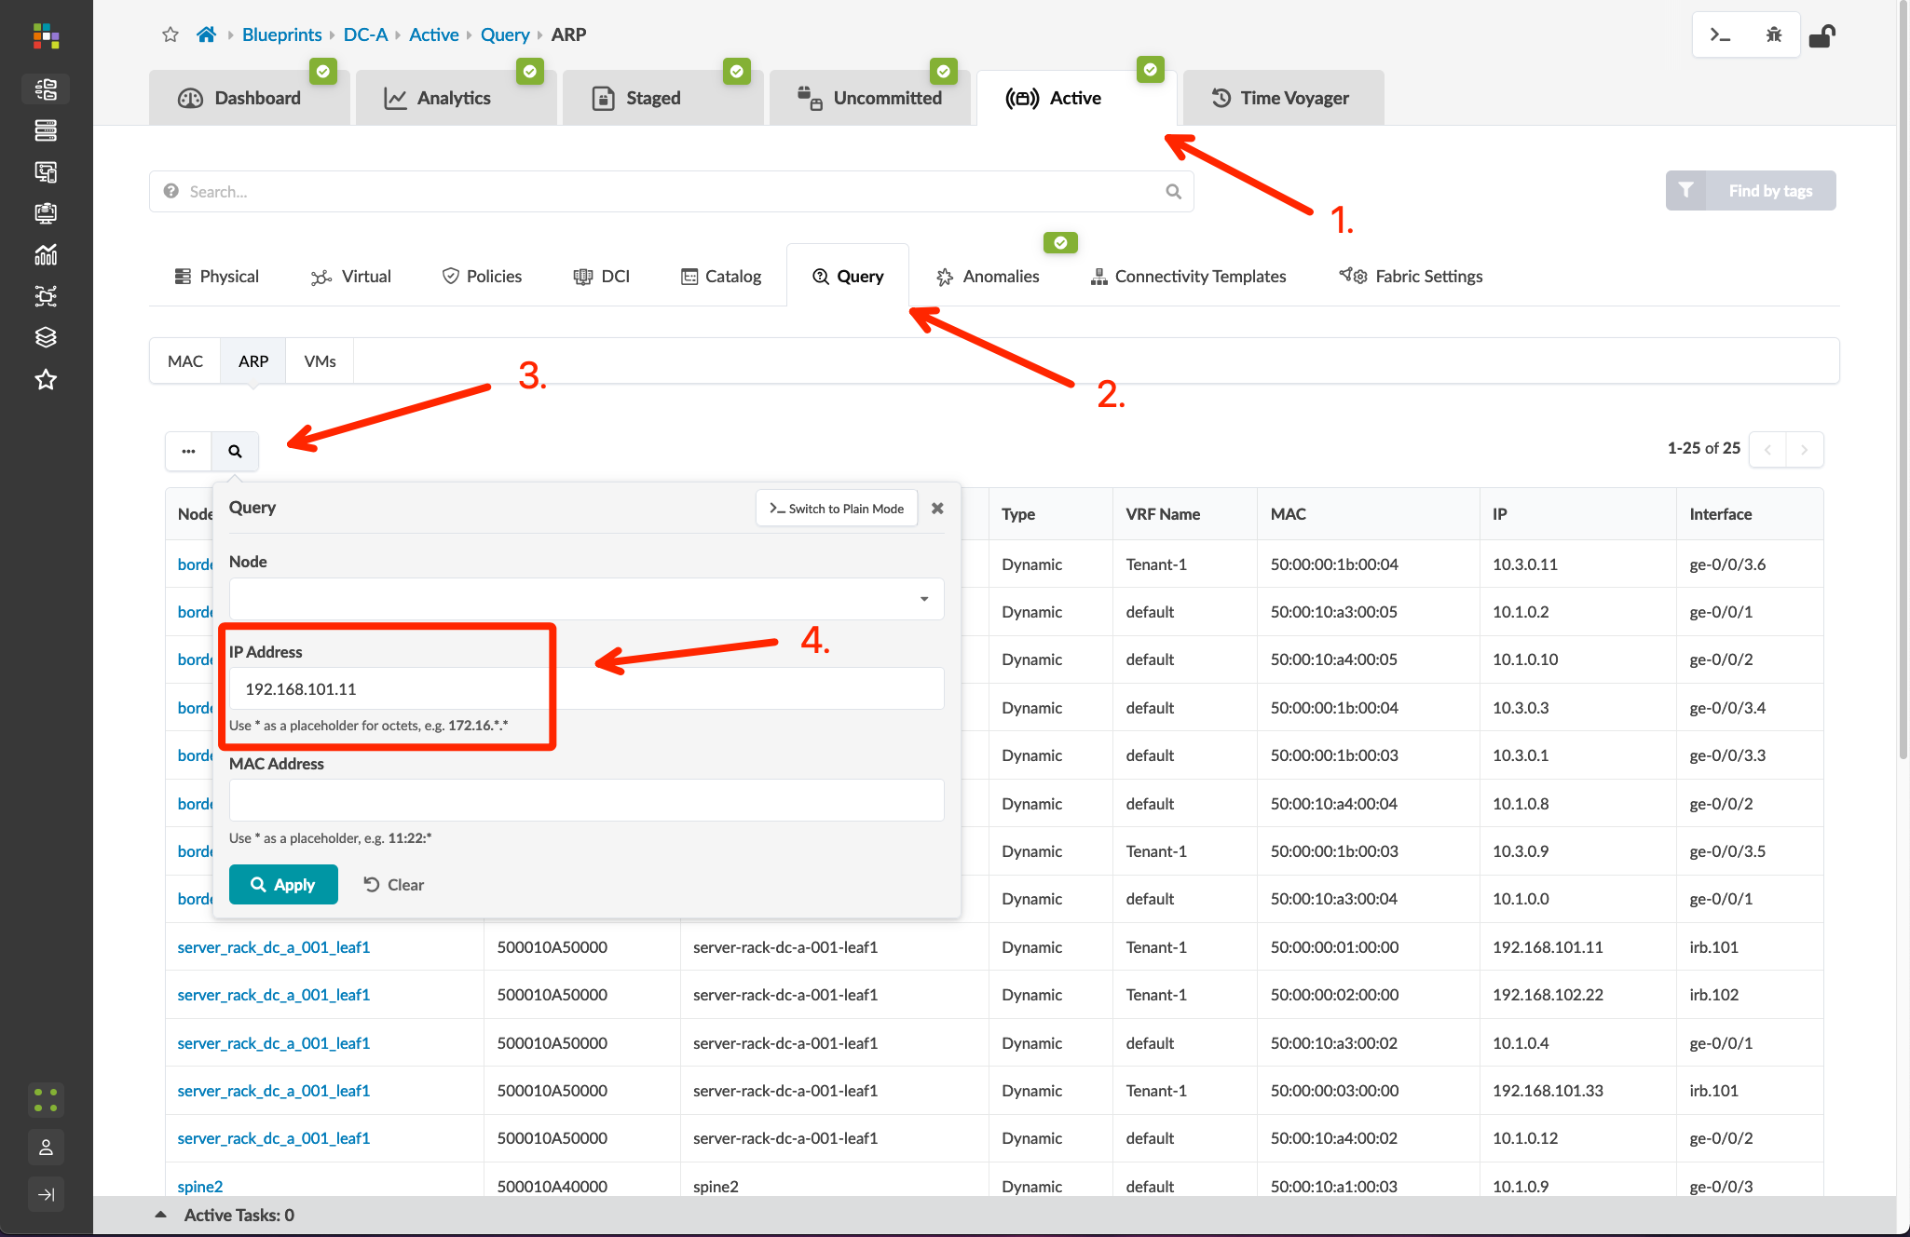
View Telemetry Data
Go to Blueprints > DC-A > Active > Query > MAC, click the “Search” box and input the MAC of a connected BMS testing node to view the fabric nodes the host is connected to
MAC info for a running node can be viewed by right-clicking the node in the eve-ng lab and selecting “Details” from the menu. Assuming you have deployed your testing nodes with a single Ethernet interface, the MAC address in the “First Eth MAC Address” field should be correct.
Go to Blueprints > DC-A > Active > Query > ARP, click the “Query” box, and input filter criteria – Apstra will display the filtered ARP table in the Blueprint
Go to Blueprints > DC-A > Active > Physical, choose a device, and view the interface counters
Go to Blueprints > DC-A > Staged > Physical, select one device, and open its information page
In the Telemetry page, click the tabs to explore some of the available information

Slide 34
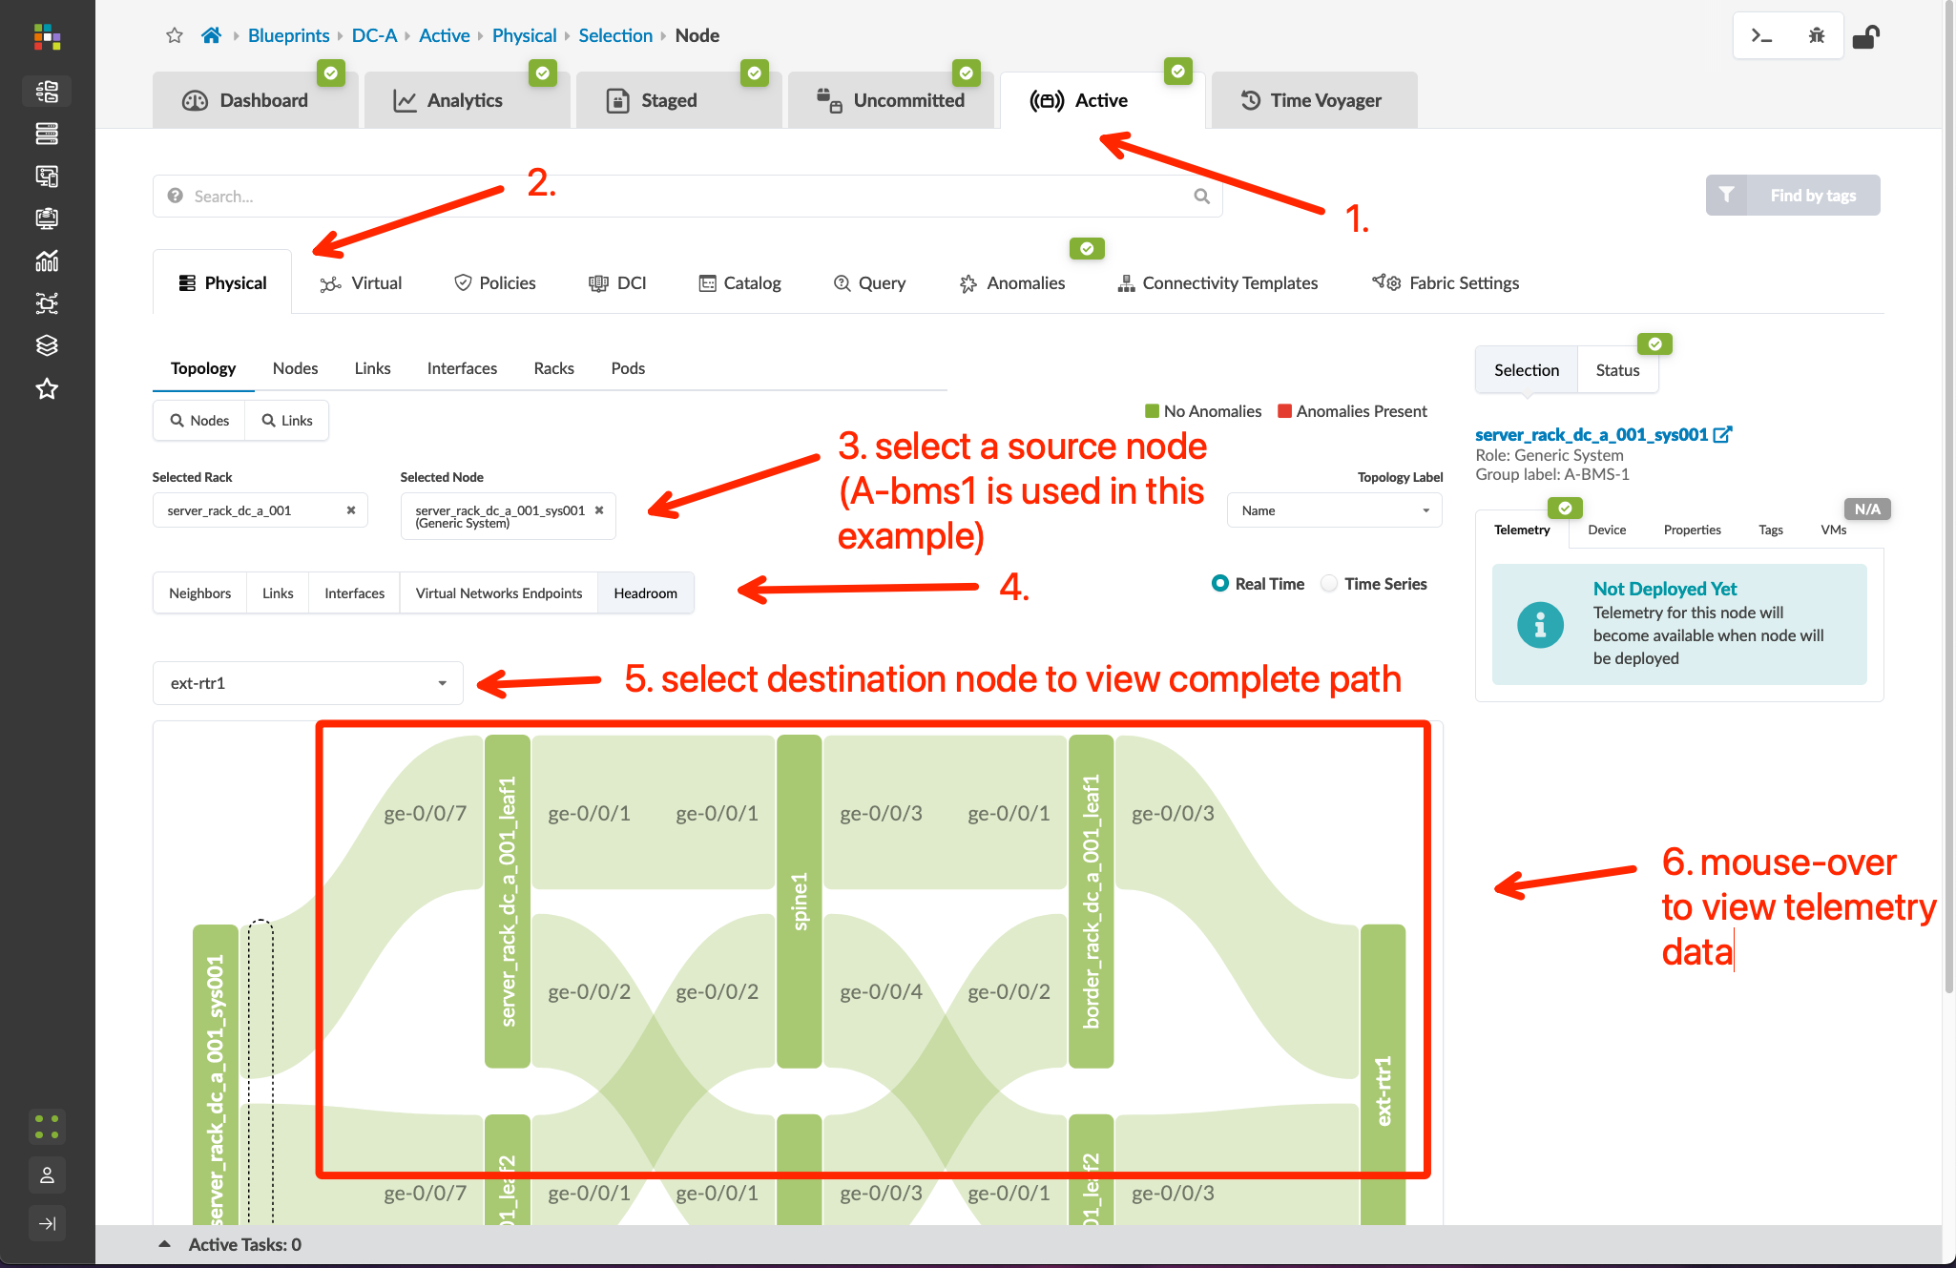
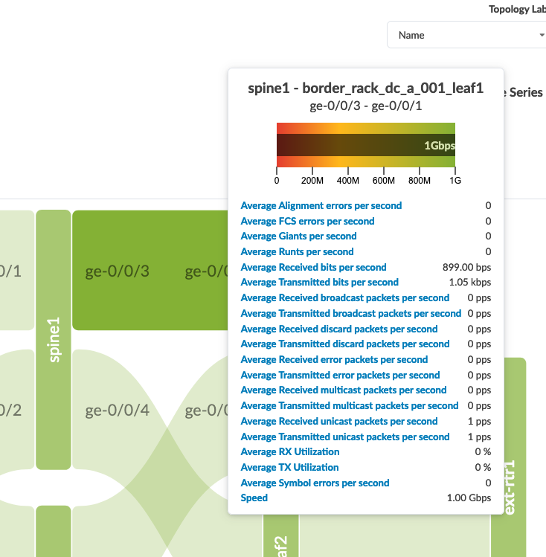
View Telemetry Data
Go to Blueprints > DC-A > Active > Query > MAC, click the “Search” box and input the MAC of a connected BMS testing node to view the fabric nodes the host is connected to
MAC info for a running node can be viewed by right-clicking the node in the eve-ng lab and selecting “Details” from the menu. Assuming you have deployed your testing nodes with a single Ethernet interface, the MAC address in the “First Eth MAC Address” field should be correct.
Go to Blueprints > DC-A > Active > Query > ARP, click the “Query” box, and input filter criteria – Apstra will display the filtered ARP table in the Blueprint
Go to Blueprints > DC-A > Active > Physical, choose a device, and view the interface counters
Go to Blueprints > DC-A > Staged > Physical, select one device, and open its information page
In the Telemetry page, click the tabs to explore some of the available information
(telemetry detail example)

Slide 35
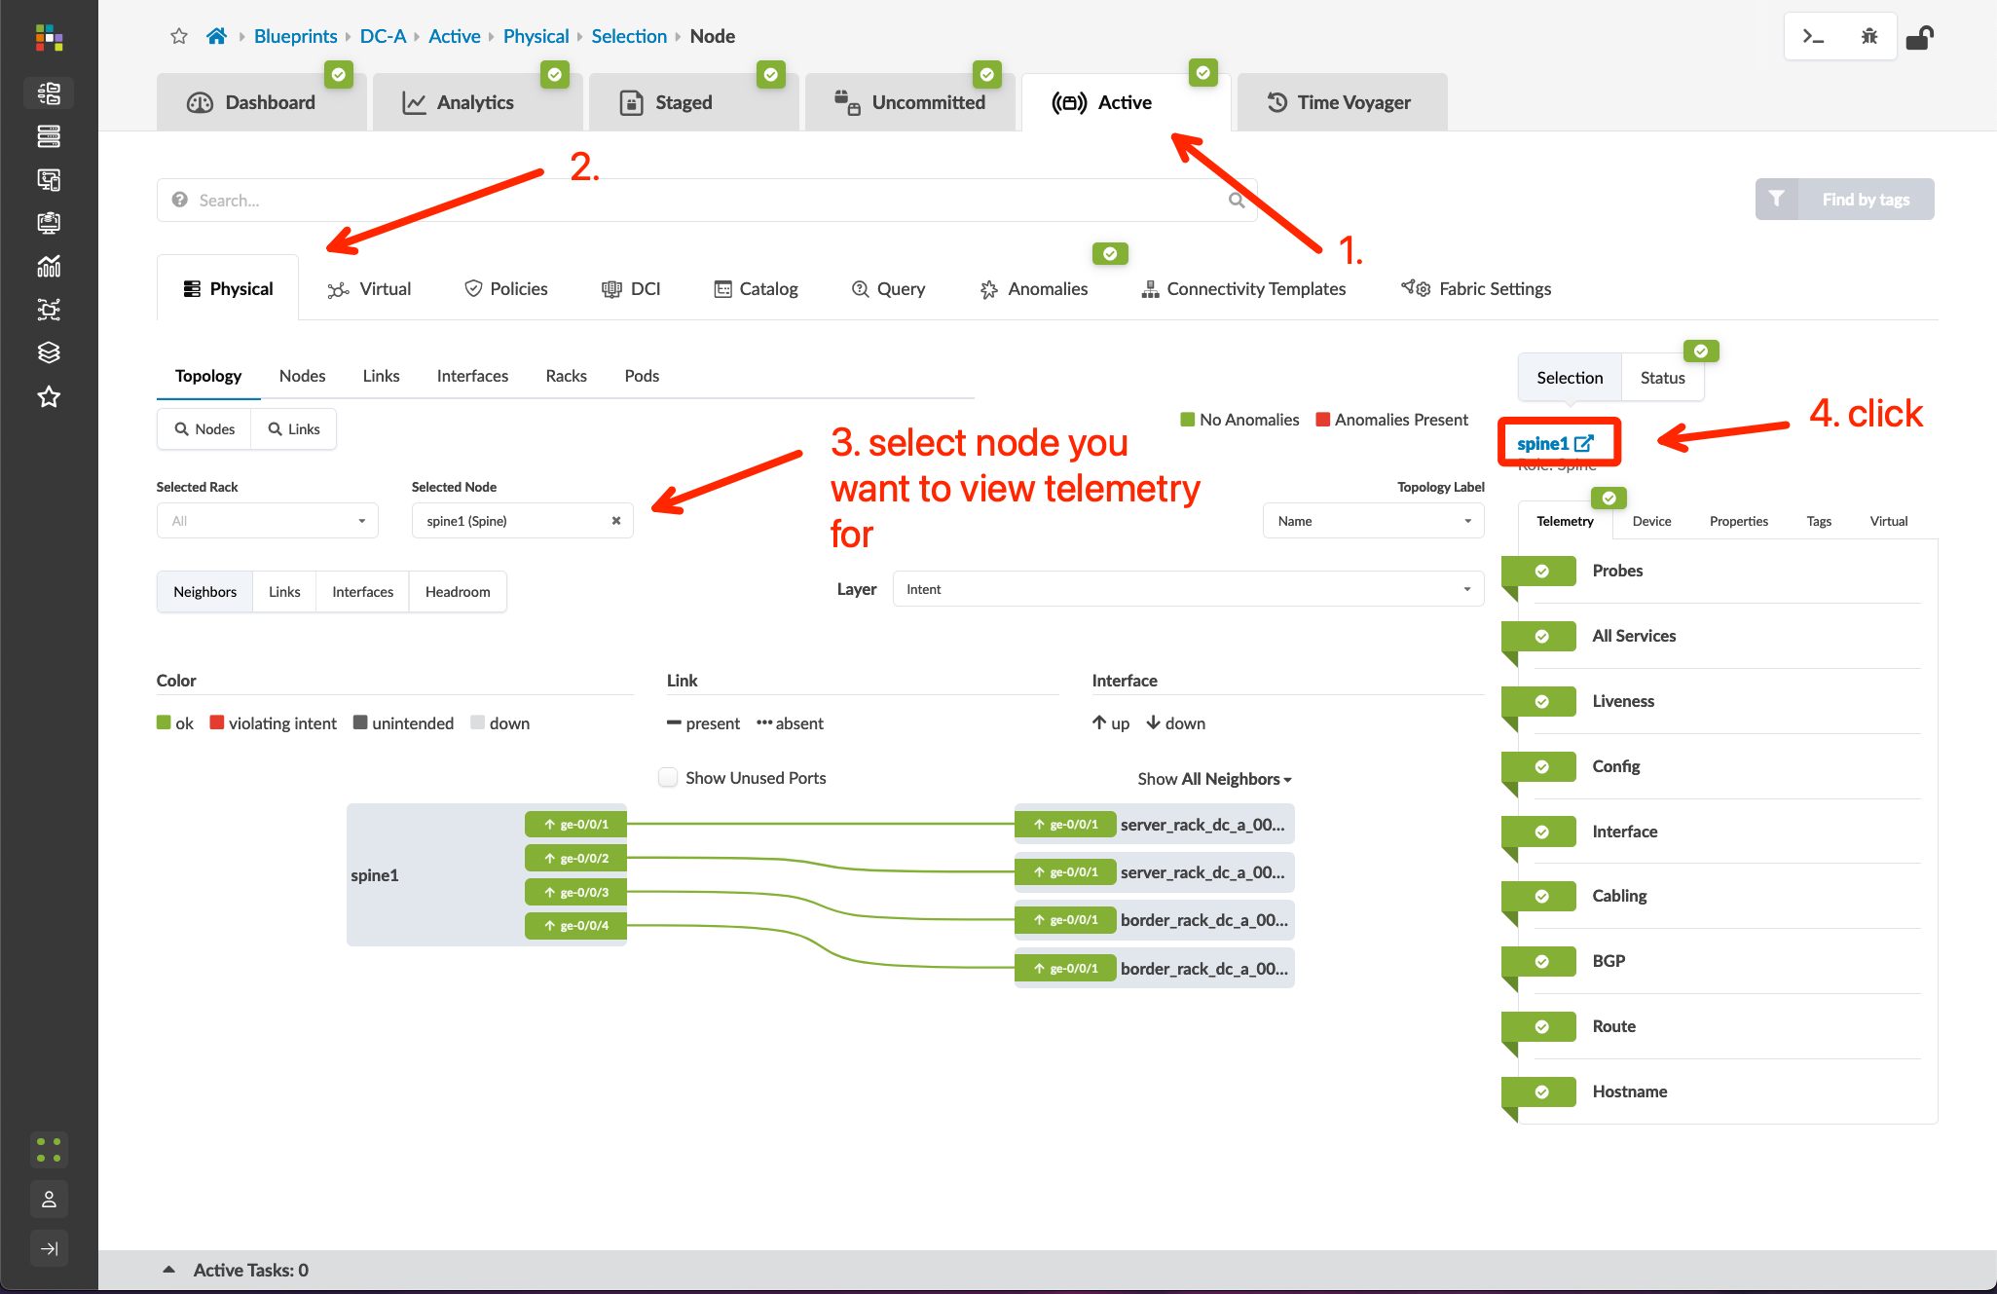
View Telemetry Data
Go to Blueprints > DC-A > Active > Query > MAC, click the “Search” box and input the MAC of a connected BMS testing node to view the fabric nodes the host is connected to
MAC info for a running node can be viewed by right-clicking the node in the eve-ng lab and selecting “Details” from the menu. Assuming you have deployed your testing nodes with a single Ethernet interface, the MAC address in the “First Eth MAC Address” field should be correct.
Go to Blueprints > DC-A > Active > Query > ARP, click the “Query” box, and input filter criteria – Apstra will display the filtered ARP table in the Blueprint
Go to Blueprints > DC-A > Active > Physical, choose a device, and view the interface counters
Go to Blueprints > DC-A > Staged > Physical, select one device, and open its information page
In the Telemetry page, click the tabs to explore some of the available information

Slide 36
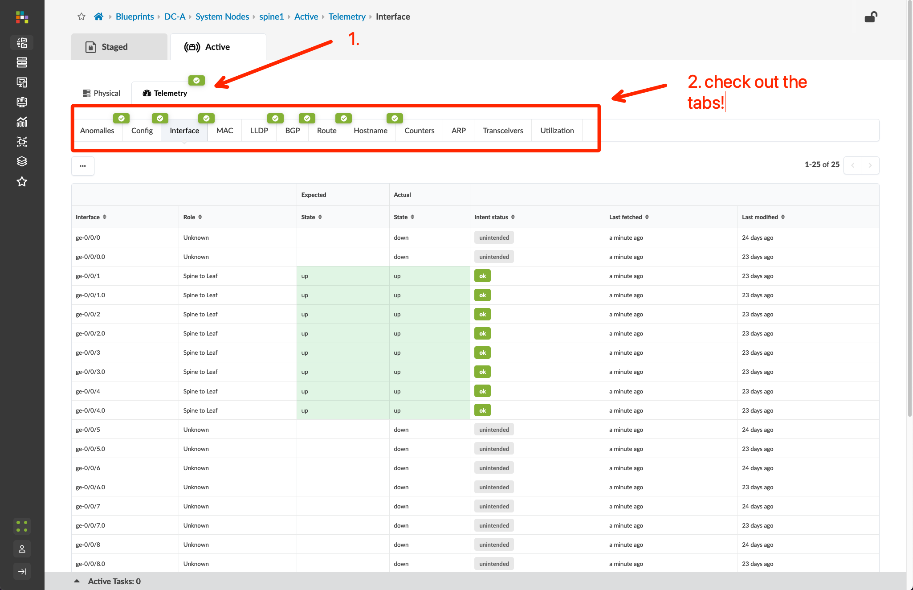
View Telemetry Data
Go to Blueprints > DC-A > Active > Query > MAC, click the “Search” box and input the MAC of a connected BMS testing node to view the fabric nodes the host is connected to
MAC info for a running node can be viewed by right-clicking the node in the eve-ng lab and selecting “Details” from the menu. Assuming you have deployed your testing nodes with a single Ethernet interface, the MAC address in the “First Eth MAC Address” field should be correct.
Go to Blueprints > DC-A > Active > Query > ARP, click the “Query” box, and input filter criteria – Apstra will display the filtered ARP table in the Blueprint
Go to Blueprints > DC-A > Active > Physical, choose a device, and view the interface counters
Go to Blueprints > DC-A > Staged > Physical, select one device, and open its information page
In the Telemetry page, click the tabs to explore some of the available information

Slide 37
Hardware Replacement
The Intent model used by Apstra ensures continuous operations in scenarios where a node is isolated from the fabric. This could be due to a code upgrade that requires a reboot, an upgrade to address scale/speed requirements, or an unexpected failure.
In this section, we will demonstrate the workflow for replacing a spine node in the fabric using the following steps:
Add a new Managed Device
Undeploy the node from the Intent
Add the new Managed Device to the Blueprint and deploy configuration to restore the original Intent
Decommission the original node, remove it from the Blueprint, and delete it as a Managed Device

Slide 38
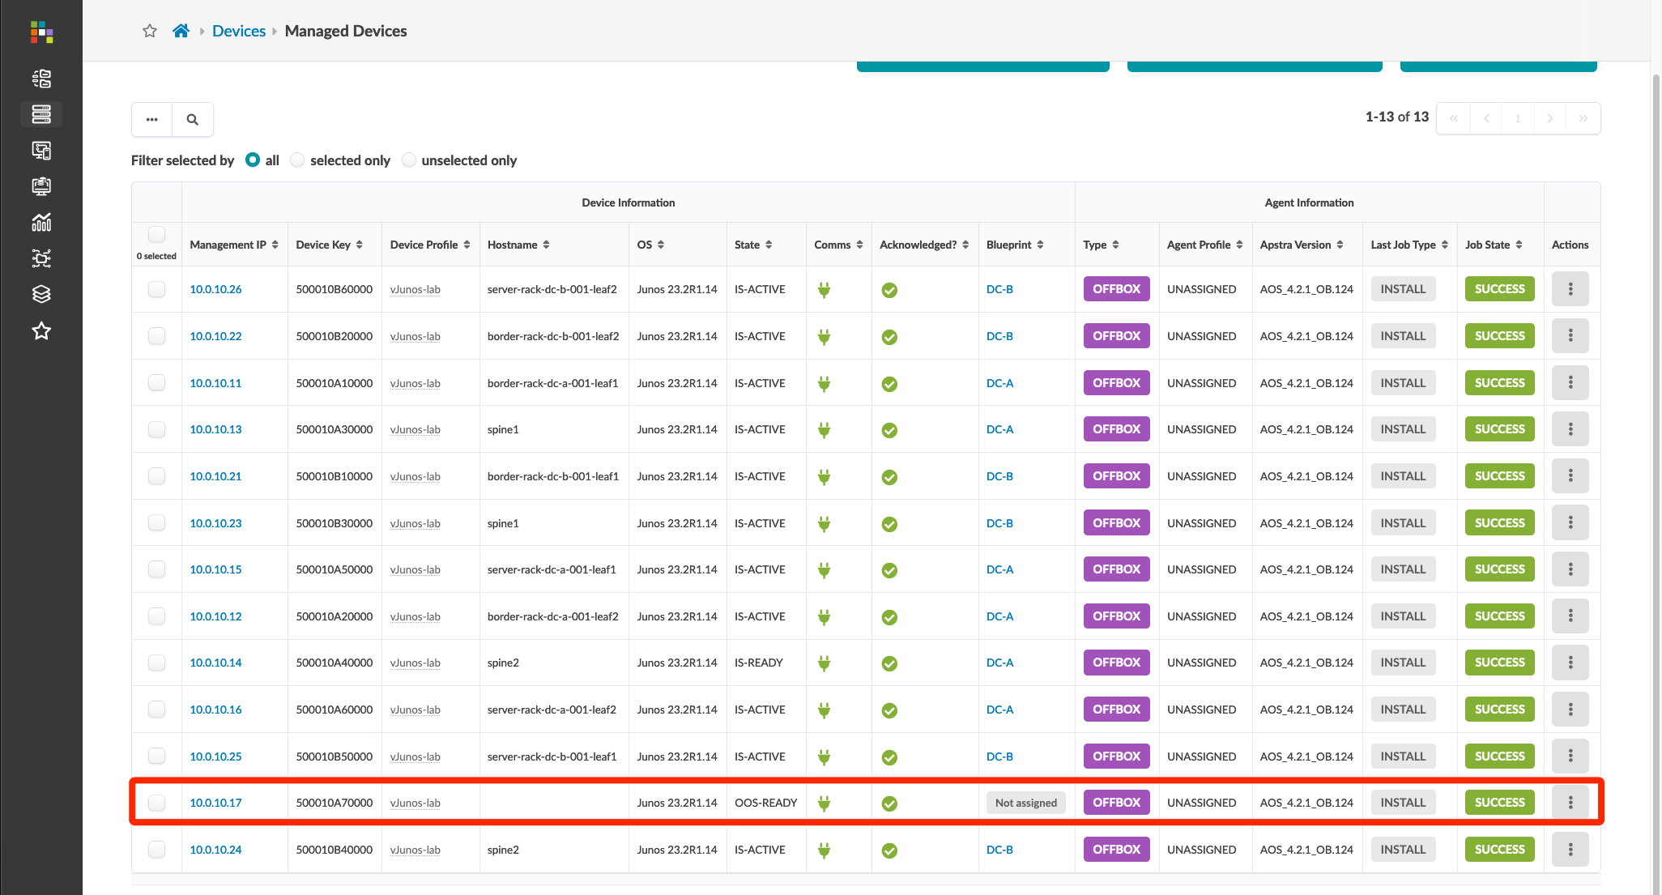
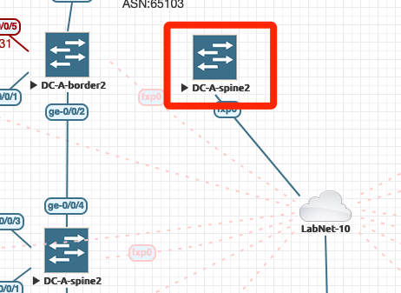
Hardware Replacement – Add a New Managed Device
Add a vJunos node to the eve-ng lab topology using the workflow in the day-0 section of this documentation
Node Name: DC-A-spine2
First Eth MAC Address: 50:00:10:a7:00:00
IP Address: 10.0.10.17
Install off-box agent, change Device Profile, and Acknowledge
4. Verify IP
3. Initial configuration
1. DHCP Reservation
I will leave the fxp0 link for this new node with its
default line color and pattern so it can be easily
differentiated from the original node
2. Powering up new node
5. New node agent installed and acknowledged

Slide 39
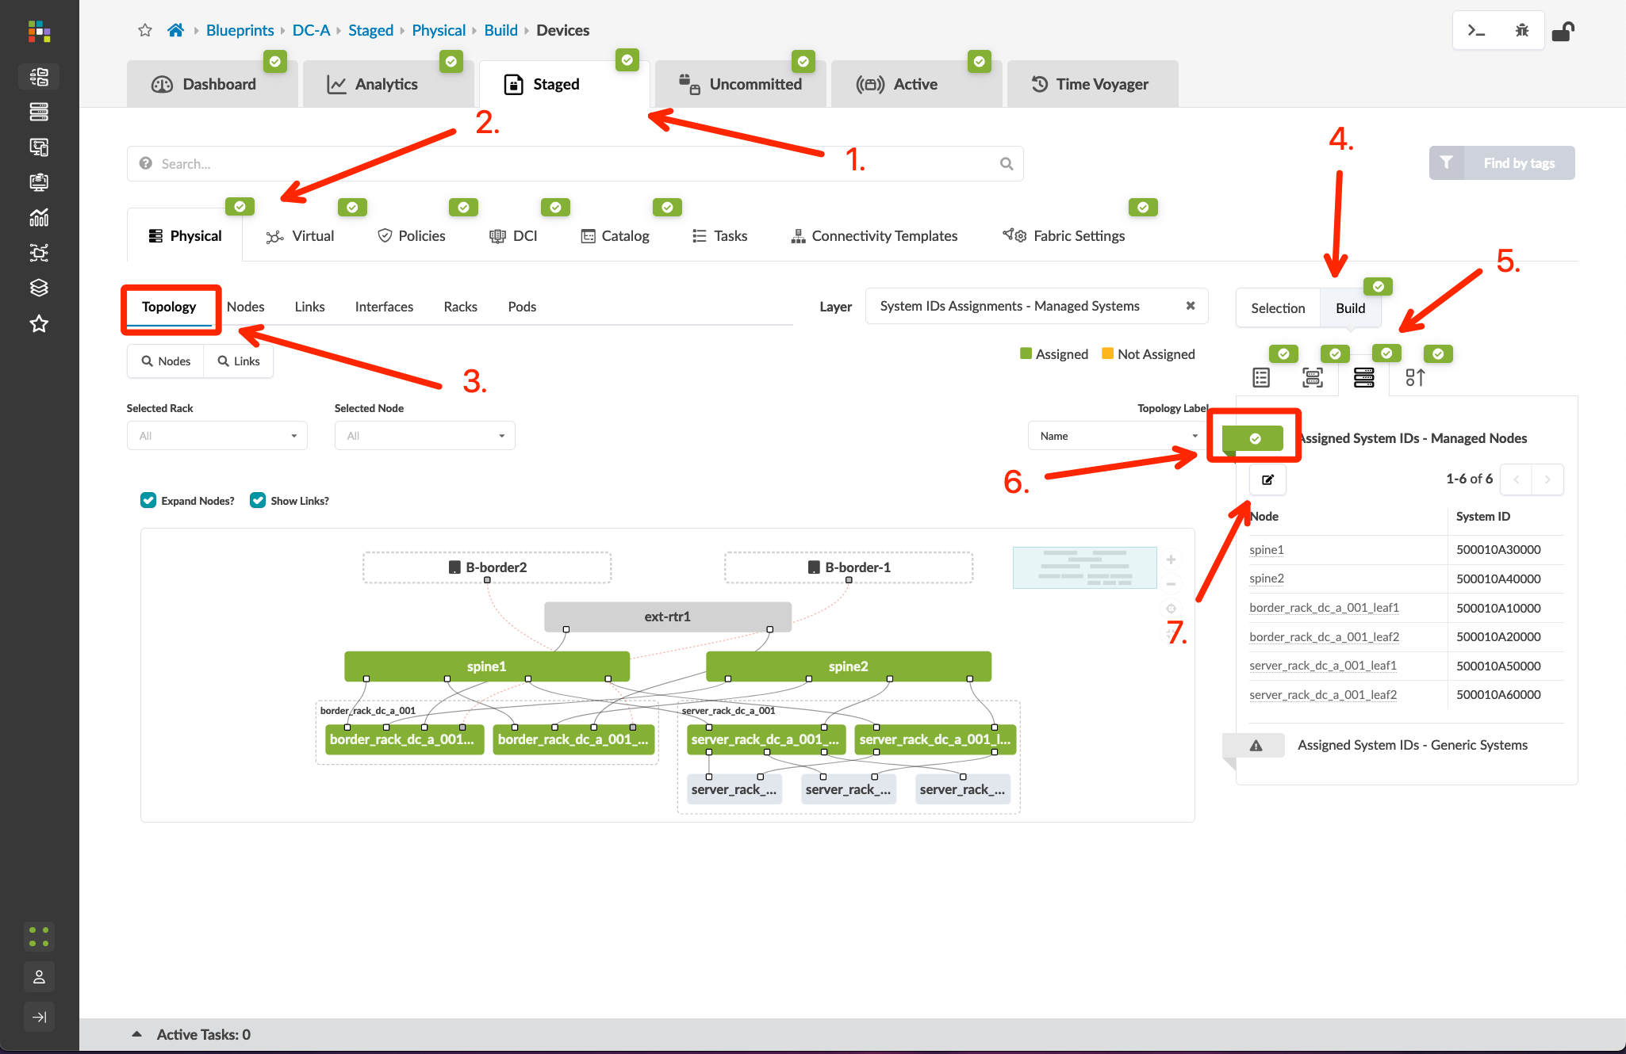
Hardware Replacement – Undeploy
Go to Blueprints > DC-A > Staged > Topology, click the “Devices” tab in the Build menu, expand the Assigned System IDs – Managed Nodes list, and click the “Change System ID Assignments” button

Slide 40
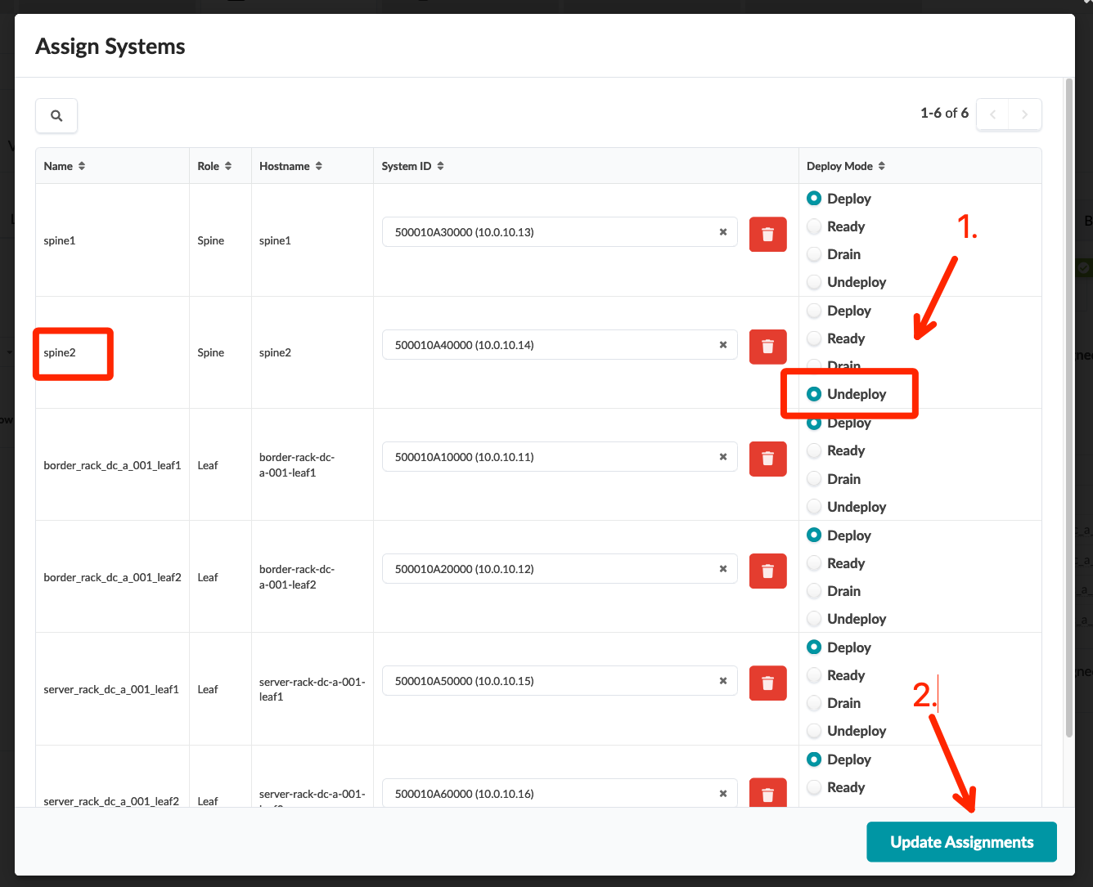
Hardware Replacement – Undeploy
Go to Blueprints > DC-A > Staged > Topology, click the “Devices” tab in the Build menu, expand the Assigned System IDs – Managed Nodes list, and click the “Change System ID Assignments” button
Set the Deploy Mode of spine2 to Drain, click “Update Assignments”, then Commit the Blueprint NOTE: If you need to remove a node from the fabric forwarding path to performance maintenance like a code upgrade, you can set the Deploy Mode to Drain. When your maintenance is completed, simply change the Deploy Mode back to “Deploy” to restore the original Intent.

Slide 41
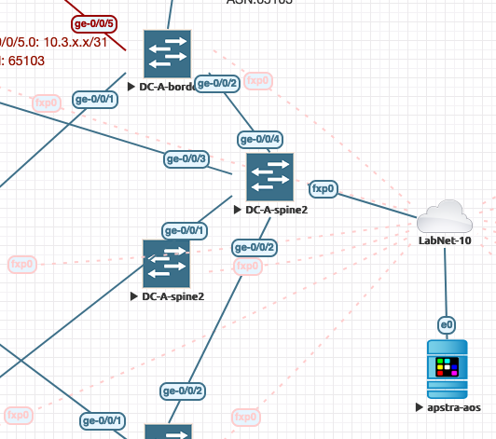
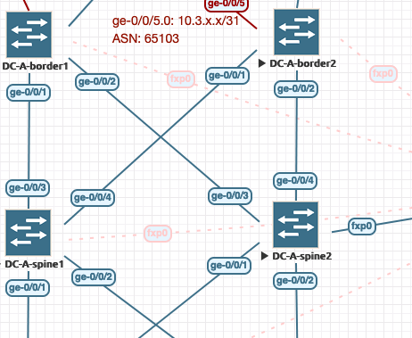
Hardware Replacement – Add the New Managed Device to the Blueprint
Delete the original spine2 node from the eve-ng lab (or delete the links and move it off to the side if you plan to restore the lab to the reference topology later), then move the new spine2 where you want it and add the links back in
NOTE: Simplify this process by deleting one link at a time from the original node, then adding that same link to the new node. Finish by moving/deleting the original node and moving the new node icon into place in your lab topology
Go to Blueprints > DC-A > Staged > Topology, click the “Devices” tab in the Build menu, expand the Assigned System IDs – Managed Nodes list, and click the Change System ID Assignments button
Remove the original System ID from spine2, assign the new System ID, set the Deploy Mode to “Deploy”, click “Update Assignments”, then Commit the Blueprint
1. Links moved to new node
2. Node moved into place

Slide 42
Hardware Replacement – Add the New Managed Device to the Blueprint
Delete the original spine2 node from the eve-ng lab (or delete the links and move it off to the side if you plan to restore the lab to the reference topology later), then move the new spine2 where you want it and add the links back in
NOTE: Simplify this process by deleting one link at a time from the original node, then adding that same link to the new node. Finish by moving/deleting the original node and moving the new node icon into place in your lab topology
Go to Blueprints > DC-A > Staged > Topology, click the “Devices” tab in the Build menu, expand the Assigned System IDs – Managed Nodes list, and click the Change System ID Assignments button
Remove the original System ID from spine2, assign the new System ID, set the Deploy Mode to “Deploy”, click “Update Assignments”, then Commit the Blueprint

Slide 43
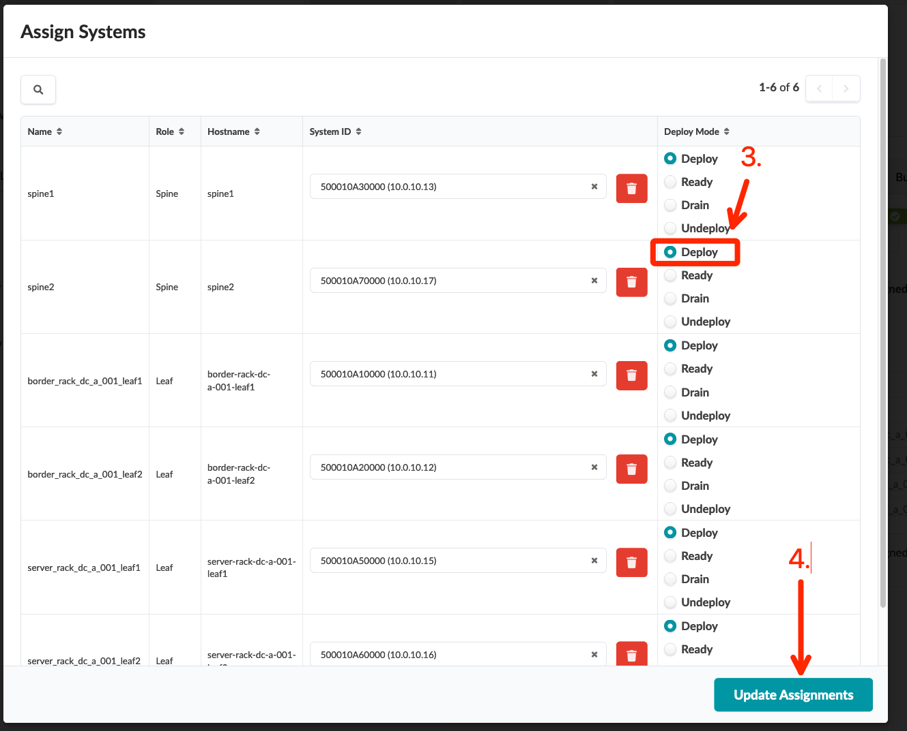
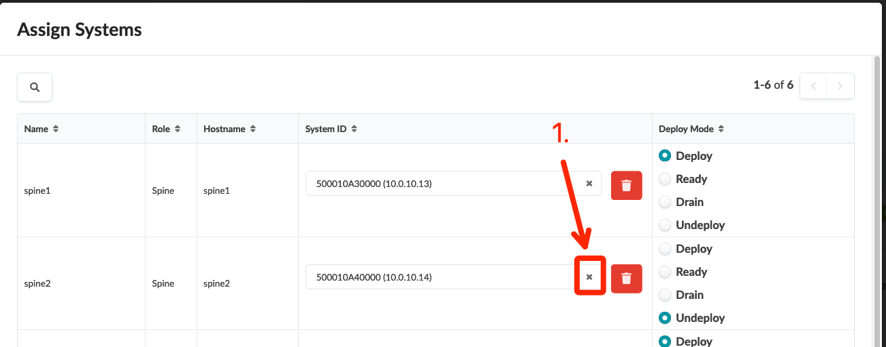
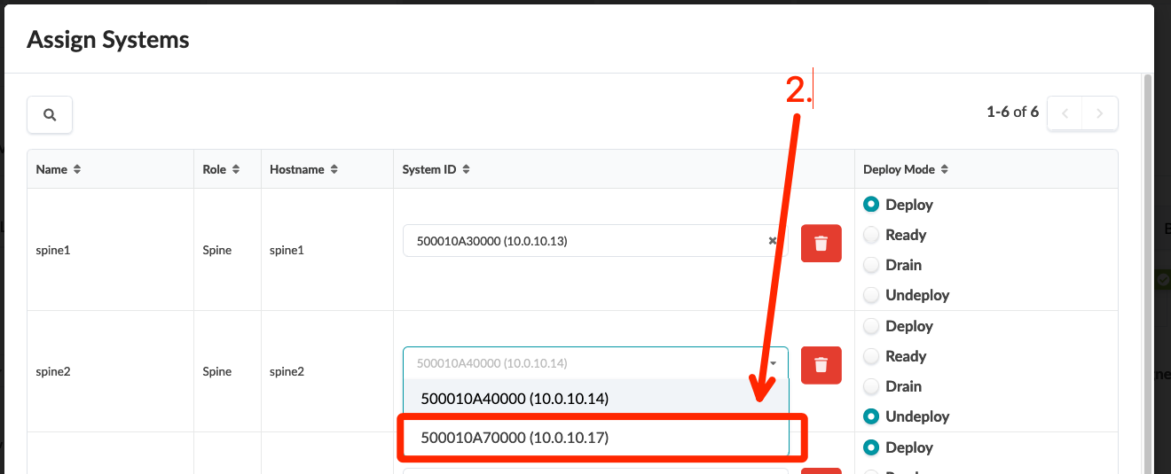
Hardware Replacement – Add the New Managed Device to the Blueprint
Delete the original spine2 node from the eve-ng lab (or delete the links and move it off to the side if you plan to restore the lab to the reference topology later), then move the new spine2 where you want it and add the links back in
NOTE: Simplify this process by deleting one link at a time from the original node, then adding that same link to the new node. Finish by moving/deleting the original node and moving the new node icon into place in your lab topology
Go to Blueprints > DC-A > Staged > Topology, click the “Devices” tab in the Build menu, expand the Assigned System IDs – Managed Nodes list, and click the Change System ID Assignments button
Remove the original System ID from spine2, assign the new System ID, set the Deploy Mode to “Deploy”, click “Update Assignments”, then Commit the Blueprint

Slide 44
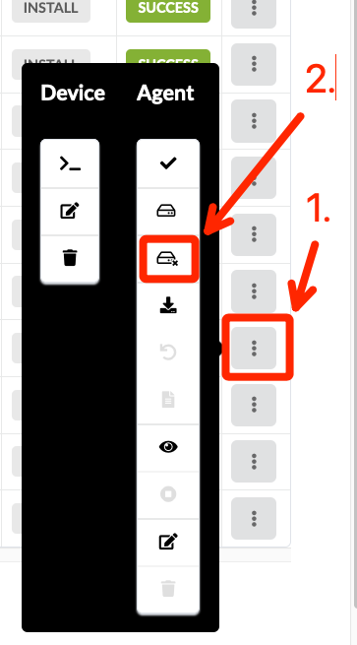
Hardware Replacement – Intent Verification and Device Decommissioning
Wait a few minutes and verify the Blueprint has no anomalies The following is optional – do not delete the original spine2 Managed Device if you wish to restore your lab to the original Intent!
Go to Devices > Managed Devices and verify the original spine2 device is not assigned to a Blueprint
Scenario 1 – Original spine2 node is still reachable from Apstra server
Click the menu button for the node and uninstall the off-box agent
After the agent is deleted, click the menu button for the node and delete the Device
Scenario 2 – Original spine2 node is not reachable from Apstra server (deleted or disconnected)
Click the menu button for the node and delete the off-box agent NOTE: the delete option is only available if the node is unreachable
After the agent is deleted, click the menu button for the node and delete the Device
Scenario 1
Scenario 2

Slide 45
THANK YOU

